Slide 1





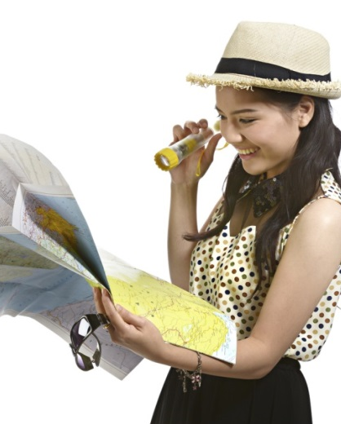
WORK AS A TOUR GUIDE
D2.TTG.CL3.01
Notes:
Trainer welcomes students to class.

Slide 2

Work as a tour guide
This Unit comprises four Elements :
1. Describe the context for the delivery of guiding services
2. Develop guiding skills and knowledge
3. Provide guiding services
4. Communicate with industry personnel
Notes:
Trainer advises trainees this Unit comprises five Elements, as listed on the slide explaining:
Each Element comprises a number of Performance Criteria which will be identified throughout the class and explained in detail
Trainees can obtain more detail from their Trainee Manual
At times the course presents advice and information about various protocols but where their workplace requirements differ to what is presented, the workplace practices and standards, as well as policies and procedures must be observed.

Slide 3

Assessment
Assessment for this unit may include:
Oral questions
Written questions
Work projects
Workplace observation of practical skills
Practical exercises
Formal report from employer/supervisor
Notes:
Trainer advises trainees that assessment for this Unit may take several forms, all of which are aimed at verifying they have achieved competency for the Unit as required.
Trainer indicates to trainees the methods of assessment that will be applied to them for this Unit.

Slide 4

Element 1 – Describe the context for the delivery of guiding
Performance Criteria for this Element are:
Identify the roles, functions and responsibilities of a tour guide
List and differentiate between types of tour guides
Identify and differentiate between the groups a tour guide may lead
(Continued)
Notes:
Trainer identifies for trainees the Performance Criteria for this Element, as listed on the slide.

Slide 5

Element 1 – Describe the context for the delivery of guiding
Describe the interpretive approach to tour guiding
Identify tour types
List the characteristics of a tour guide
Describe tour guiding principles
Notes:
Trainer identifies for trainees the Performance Criteria for this Element, as listed on the slide.
Class Activity – General Discussion
Trainer leads a general class discussion by asking questions such as:
What is a Tour Guide and what do they do?
What experience do you have of being of being a Tour Guide?
What different types of tours are you aware of?
What tours have you been on and what was they experience like? Why?
What do you think are the characteristics required by a good/effective Tour Guide?

Slide 6

Identify the roles, functions and responsibilities of a Tour Guide
Tour Guides are required to discharge a wide range of roles, functions and responsibilities
Tour Guides are often seen as ‘the mortar which binds a tour together’
Notes:
Trainer introduces topic stating:
Being a Tour Guide/Tourist Guide requires attention to a wide range of roles, functions and responsibilities
Tour Guides are often referred to as ‘the mortar that binds the tour together’.

Slide 7
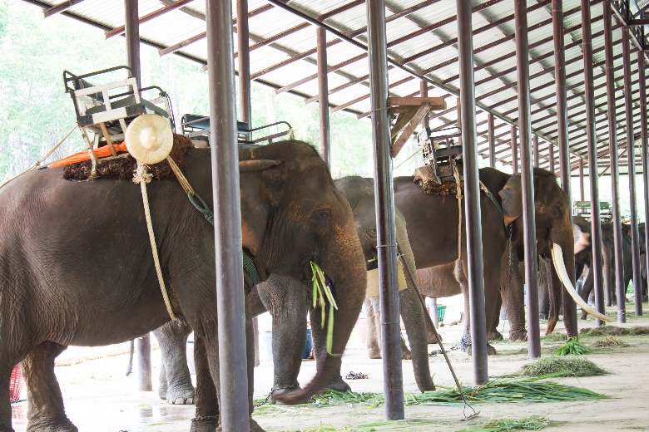
Identify the roles, functions and responsibilities of a Tour Guide
Roles, functions and responsibilities of a Tour Guide:
Manager and leader
(Continued)
Notes:
Trainer identifies the range of roles, functions and responsibilities of a Tour Guide:
Manager and leader
This is vital and central role because tourists/visitors and the employer expect the Tour Guide to take charge/control of the tour and tour group members.
This can involve:
Managing the tour group members and leading the tour so:
The schedule of the tour is adhered to
No-one gets lost
Behaviour is acceptable
All participants get maximum value from the tour
Issuing items as required for the tour – such as tickets, badges, equipment, handouts and other group-specific or tour-specific items
Briefing people – on practical tour-related issues, and giving necessary operational and/or safety-related instructions
Taking responsibility for the tour group – highlighting the need to:
Ensure comfort of the group
Guarantee their safety and security
Respond to their individual needs/preferences
Make sure visitors/tour group members enjoy their experience and ensure the tour lives up to advertisements/promises made about it and enhances the reputation and image of the Tour Operator and the destinations and host country
Comply with all legal, moral and ethical requirements – including commonly accepted social standards/norms
Monitor and supervise actions, language and interactions of the tour group
Escorting tour group members to protect them and ensure their safety – this can mean taking charge and taking appropriate action when an emergency arises or when there is a need to take decisive action to accommodate unforeseen/unexpected circumstances
Demonstrating confidence and credibility – by dressing appropriately, by acting and speaking professionally, by proving things are organised, by providing relevant and interesting information and insight into what is said
Acting as a role model – about how tour group members should act/behave, about where they can go and cannot go, how to talk to others
Directing, navigating and moving people in relation to where they go, what they do, how long they spend in an area/on an activity
Showing people what to do – such as demonstrating skills, demonstrating safety equipment/requirements, demonstrating local activities
Path-finding – to show the way so people know where to go.

Slide 8

Identify the roles, functions and responsibilities of a Tour Guide
Mediator
Communicator
Cultural host
(Continued)
Notes:
Trainer continues identifying the range of roles, functions and responsibilities of a Tour Guide:
Mediator
This is needed in order to:
Mediate problems and/or conflict within the group – or between individuals in the group
Mediate issues between the tour and the place where the tour is being conducted – which may relate to issues such as:
Timing of activities
Access to exhibits/areas
Duration of demonstrations
Movement of groups
Actions of individuals within the tour group.
Tourist Guides are often required to be the ‘social lubricant’ (regarded as a ‘social facilitator’) between members of a group to handle disputes and facilitate individual engagement with the tour (that is, to draw out those who appear alone, reluctant to participate or unhappy): high levels of social and interpersonal skills are essential for those who deliver tours.
All Tourist Guides must be a ‘people person’.
Communicator
This involves:
Welcoming people to the tour – genuinely, warmly, personally and sincerely
Delivering a commentary to tour group members – to explain, inform, illustrate and interpret the tour and to promote cultural awareness
Responding to questions – asked by tour group members
Providing information – about tour sites, locations, destinations, surrounding areas, products and services, events and festivals, history and culture, business, and (generally speaking) anything to do with the local area/country.
Being a good communicator also requires interpretation of aspects of the tour (such as culture and customs, history, the environment, social factors and the economy)
Cultural host
This relates to promoting and respecting local culture.
More on this is presented on later slides.
Class Activity – Guest Speaker
Trainer arranges for a Tour Operator to attend and talk about their expectations of Tour Guides in relation to their roles, functions and responsibilities.

Slide 9

Identify the roles, functions and responsibilities of a Tour Guide
Teacher and mentor
Environmentalist
Entertainer
(Continued)
Notes:
Trainer continues identifying the range of roles, functions and responsibilities of a Tour Guide:
Teacher and mentor
All tours contain an element of teaching people something or facilitating their learning.
This means the tour guide must have:
Extensive knowledge of the topic/area which is the focus of the tour – so they can show, tell and explain as required as well as respond to questions
Extensive knowledge of the wider area/country/region – in order to be an ambassador for the country/location
Skills and techniques to enable them to impart the knowledge they have – to groups and individuals.
Environmentalist
All Tourist Guides are expected to:
Advise tour group members about actions to help preserve and protect all environments they visit – to demonstrate responsibility and support the principle us sustainable tourism
Take action to minimise tourist impact – on the environment
Subscribe to the principles of sustainable tourism
Inform tourists of relevant local environmental issues and concerns – in relation to environmental issues, problems and initiatives.
Entertainer
All tours have some degree of entertainment and the Tour Guide needs to be able to:
Optimise enjoyment – of the group
Enhance interest – in the tour and activities
Make people smile and laugh -= at appropriate times and for appropriate reasons
Captivate and amuse – people on tours, especially younger ones/children.
Class Activity – Internet Research
Trainer facilitates student research of and discussion regarding content of following and other similar/relevant websites:
http://satic.com.au/images/uploads/industry_resources/sustainable_tourism_principles.pdf

Slide 10

Identify the roles, functions and responsibilities of a Tour Guide
Safety and security officer
Sales person
Administrator
Notes:
Trainer continues identifying the range of roles, functions and responsibilities of a Tour Guide:
Safety and security officer
Delivering a tour can require:
Explanation of safety requirements – telling people what they should and should not do to remain safe
Distribution of safety equipment – and demonstration of how to wear/use it, as well as assisting people to get into safety/protective clothing
Observing and monitoring tour group members – to ensure they do not get lost, injured or place themselves (or others) in danger
Monitoring of the environment – to predict potential threats/warning signs
Taking appropriate action when danger threatens or an emergency situation occurs – or when a person is injured.
Sales person
A Tour Guide can be required to:
Promote retail opportunities – available within the tour to optimise sales
Encourage referral business – that is, encouraging people on the tour to suggest/recommend the tour and/or the country to their families and friends
Generate repeat business – where participants come back for another tour
Advertise any aspect of the business/site – as determined or required by management
Administrator
Which can involve:
Liaising with other operators and businesses – to organise or otherwise facilitate tours and visits
Planning and organising tour activities – to suit identified need
Arranging supporting inclusions for the tour – such as food/meals, drinks, transport, accommodation and other items appropriate to the type of tour and identified need of tour group members
Completing necessary reports – as required by employer
Maintaining records – of each tour as necessary.
Class Activity – Guest Speaker
Trainer arranges for Tour Guide/s to attend and talk to students about their job and the roles, functions and responsibilities inherent in their work.

Slide 11

List and differentiate between types of tour guides
There is a need to understand:
Tour Operators may employ a variety of different Tour Guide types – or just one type
Tour Guides can elect to be self-employed
Some countries prescribe certain classifications – requiring Tour Guides to undertake identified training and obtain nominated qualifications
Notes:
Trainer discusses context for different types of Tour Guides stating within the industry it is important to understand:
Tour Operators can elect to employ a variety of different classifications of Tour Guides – or they may only employ one type depending on the profile of tours they offer
Individuals can choose to be self-employed – and present/promote themselves as any type of Tour Guide they want to
Some countries stipulate classifications of Tourist Guides – which underpin their attempts to regulate entrants into the Tour Guiding industry.

Slide 12

List and differentiate between types of tour guides
Types of Tour Guides may include:
On-site attractions Tour Guide
(Continued)
Notes:
Trainer states it is common for the following types of Tour Guides to be available for employers and visitors/tour groups to choose from:
On-site attractions guides
These Tour Guides:
Are specific to one (or a limited number) of venues, attractions, parks, gardens or destinations
Meet and greet tourists on arrival
Have an extremely detailed knowledge of the site they are working in
Will be expected to promote sales within the site/attraction
Manage tourists and visitors while they are on-site
Will frequently:
Lead on-site tours; Conduct demonstrations relevant to the site/type of attraction; Supervise activities – such as experiential learning; Provide commentaries; Drive site-specific transport/vehicles; Organise and monitor on-site inclusions – such as meals, photo opportunities, displays, events, distribution of materials, rides, games; Farewell visitors and encourage repeat and referral business.
Class Activity – Guest Speaker
Trainer arranges for a Tour Guide of the type identified on the slide to attend and talk about their role, functions and responsibilities.

Slide 13
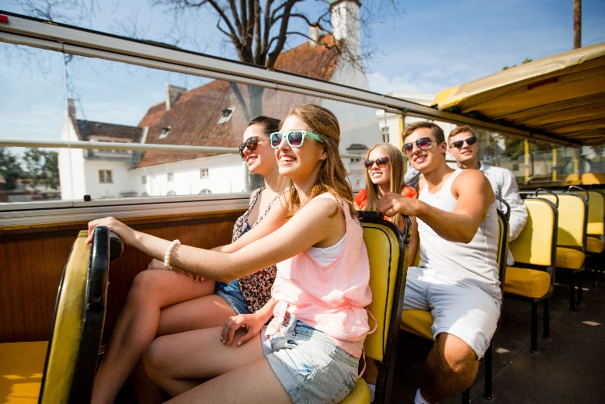
List and differentiate between types of tour guides
City Guide
Government Guide
(Continued)
Notes:
Trainer continues identifying and describing work of different types of Tour Guides:
City guides
These Tour Guides:
Specialise in leading tours of one or more cities. May conduct:
‘City walks’ ; ‘Bicycle tours’; ‘Hop on, hop off’ tours – using public transport; Tours of a specific area of a city; Tours of specific business/property types within the city – such as fashion and clothing houses, restaurants, electronic wholesalers/retailers; Tours of certain lifestyle/life choices – such as medicine, nightlife, arts and culture, museums, history, activity-based options
Often work closely with:
Councils; Tourism bodies including semi=government authorities; Local businesses.
Government guides
Government guides are employed by the government or government-funded bodies or agencies. These Tour Guides:
Are employed by the government – but may not be obviously designated (to visitors/tourists) as government employees
Need to comply with pre-requisite compliance requirements – which often relates to minimum requirements for experience as well as holding designated qualifications and/or a local tour licence/permit
Are often to communicate prescribed information to visitors – as part of the government effort to impart knowledge and/or promote a certain point of view or initiative
May:
Lead tours of government buildings and other government-owned and managed destinations
Conduct tours of general areas, cities and other attractions.
Class Activity – Guest Speakers
Trainer arranges for Tour Guides of the type identified on the slide to attend and talk about their role, functions and responsibilities.

Slide 14

List and differentiate between types of tour guides
Specialised Guide
Independent Guide
(Continued)
Notes:
Trainer continues identifying and describing work of different types of Tour Guides:
Specialised guides
These Tour Guides:
Specialise on one or more type of tours – such as, for example:
Action and adventure tours; Historic tours; Culture tours; The Arts’ Eco-tourism and nature
Must have:
Extensive knowledge of the areas they are specialising in; Sound skills relating to the activities which are the focus of their tours; Often operate as other guide types – in addition to their chosen specialisation’
May be classified as such by local regulations – for example Singapore STG classification
Independent guide
An independent guide:
Is self-employed
May also work for Tour Operators, Government agencies or attractions or destinations on a contractual basis – in any Tour Guide capacity as listed in this section
May need to be registered by local authorities – in order to function in this capacity
May need to ensure they meet local compliance obligations imposed by law/the authorities – which may relate to:
Advertising and promotion; Conduct and ethical practices – including complaint resolution; Insurance coverage.
Class Activity (1) – Internet Research
Trainer facilitates student research of and discussion regarding content of following and other similar/relevant websites:
online.visitsingapore.com/tgls/application/STG_FAQ_App.pdf
Class Activity (2) – Guest Speakers
Trainer arranges for Tour Guides of the type identified on the slide to attend and talk about their role, functions and responsibilities.

Slide 15
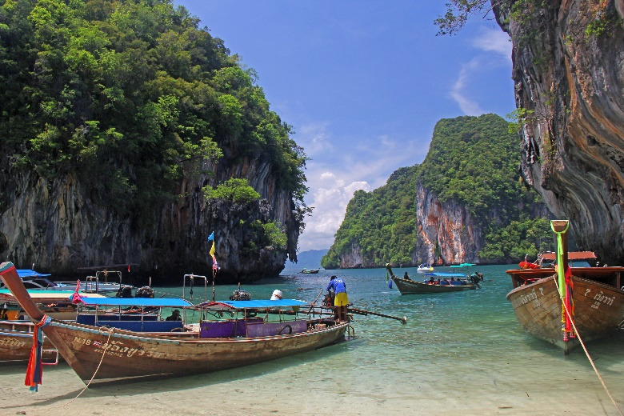
List and differentiate between types of tour guides
Business and industry Guides
Duration-based Guides
Driver Guides
Notes:
Trainer continues identifying and describing work of different types of Tour Guides:
Business and industry guides
These Tourist Guides:
Are ‘Specialised guides’ who focus on leading tours to:
Nominated business houses; Specific industry types or sectors
May be self-employed or employed by the businesses/industries they serve
Can operate (wholly or partially) on a ‘commission basis – based on the sales made to visitors/tour groups while they are at individual establishments.
Duration-based guides
These Tour Guides may be:
One-day Tour guides – leading tours of (generally) six to twelve hours duration
Extended Tour Guides – conducting multiple day tours.
They:
May be required to drive a vehicle – or may work in conjunction with a dedicated driver
May be required to cook/prepare meals – or may work with a dedicated cook
Can be a generalist Tour Guide – with general knowledge about an area and/or a range of topics, or a Specialised Tourist Guide
May be required to arrange and supervise accommodation of tour group members
Will need exceptional levels of interpersonal and communication skills – given the length and nature of the contact they have with visitors
Must monitor group dynamics more than other types of Tour Guides given the longer duration of tours and the greater potential for problems to arise.
Driver guide
These Tour Guides:
May be any classification of Tour Guide as identified above – who combine their other Tour Guide duties with driving a vehicle
Often need to hold a nominated type of driving licence as appropriate to the type of vehicle being driven – which may be:
A car or van with limited passenger capacity; A four-wheel drive vehicle – especially on adventure/remote area tours; A bus or coach
May drive:
Vehicles on public roads; Conveyances within the boundaries of attractions – such as tractor-trains
Will often need to have:
Specialist driving training; Nominated experience/ability with vehicle maintenance and repairs.
Class Activity – Guest Speakers
Trainer arranges for Tour Guides of the type identified on the slide to attend and talk about their role, functions and responsibilities.

Slide 16
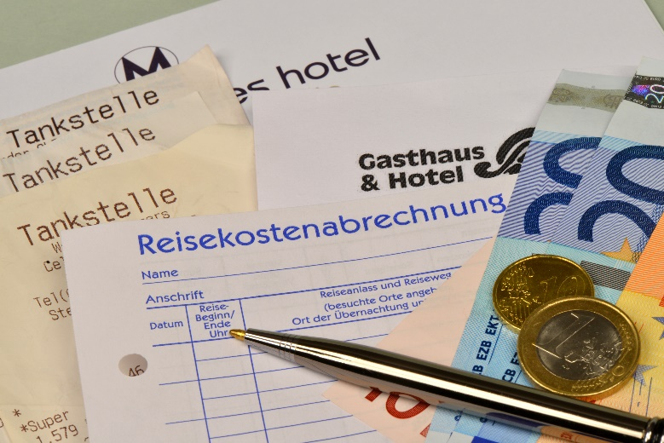
Identify and differentiate between groups a Tour Guide may lead
All inclusive tour:
Covers all ‘inclusions’
Types/form of inclusion will depend on Tour Operator and type of trip/destinations
Inclusions commonly include:
Tickets/fares/travel
Meals and accommodation
Transfers and tips
Notes:
Trainer leads discussions on industry terms and their definition/interpretation:
All inclusive tour
An all inclusive tour is (more or less) what the name implies
It is a tour where all of the inclusions are included in the purchase price. All inclusive tours generally apply to coach and sea travel/cruises
The exact nature of these inclusions will vary depending on the tour and, of course, they can also vary between providers/Tour Operators
Common inclusions are:
Tickets/fares/travel; Transfers; Accommodation; Meals; Certain beverages – alcohol is usually not included; Side trips and sight-seeing; Listed activities – excursions, attractions, events, entertainment; On-site services/facilities – gymnasium, sports, spa, games; Tips/gratuities.
Class Activity – Handouts
Trainer distributes and discusses promotional materials from Tour Operators advertising the tour type identified on the slide.

Slide 17
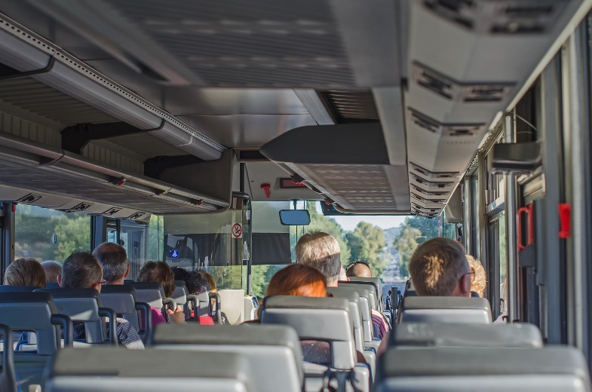
Identify and differentiate between groups a Tour Guide may lead
Escorted tour:
Led by a Tour Guide, Tour Director or Tour Leader
Favoured by many as they feel safer in a group
Tour Guide/Leader provides a wide variety of support services to all tour group members
Notes:
Trainer continues leading discussions on industry terms and their definition/interpretation:
Escorted tour
An escorted tour is a group tour where the travel agent or organising agency provides a Tour Guide (or tour group leader or ‘tour director’) who escorts the tour group members for the duration of the tour
An escorted tour is distinct from a self-guided tour where the traveller makes their own arrangements and makes their own way
Escorted tours may be sea-based or land-based, and generally all inclusive
Many people prefer an escorted tour as they fell safer and believe they will have less problems and/or get more from the experience when in the presence of an experienced leader.
The tour leader will:
Assist with boarding protocols when getting on a coach, ship, train or other transport
Facilitate check-in at hotels and entry to attractions and other sites
Help solve problems which may relate to customs, immigration, local laws and customs
Provide advice and information in relation to the areas/sires visited
Liaise as required with local officials, businesses and individuals
Monitor the safety and security of the group and take appropriate action when needed
Manage the tour group and address any interpersonal issues which may arise.
Class Activity – Handouts
Trainer distributes and discusses promotional materials from Tour Operators advertising the tour type identified on the slide.

Slide 18

Identify and differentiate between groups a Tour Guide may lead
Full independent tour:
Tourist purchases package/deal
Trip/tour is undertaken without a Tour Guide
Gives tourist more flexibility and freedom to ‘do their own thing’
Notes:
Trainer continues leading discussions on industry terms and their definition/interpretation:
Fully independent tour
This is an unescorted tour
The client purchases a package deal/tour – called a Fully Independent Package – (which may include travel, accommodation, meals, admission to sites/attractions, car hire) from an agent or Tour Operator and then undertakes the trip on their own without a tour leader or Guide
This gives the customer the benefit of a planned tour but the flexibility/freedom to do (within the constraints of the itinerary) what they want, when they want.
Class Activity – Handouts
Trainer distributes and discusses promotional materials from Tour Operators advertising the tour type identified on the slide.

Slide 19

Identify and differentiate between groups a Tour Guide may lead
Group inclusive tour:
Arranged for/bought by a group
Includes nominated inclusions
Attractive to groups because they are always ‘cost effective’ for them
Notes:
Trainer continues leading discussions on industry terms and their definition/interpretation:
Group inclusive tour
A GIT is a tour arranged for, or bought by, a group from an agent or Tour Operator
All members of the group follow the same itinerary and have access to the same inclusions
It may be escorted or unescorted
It is ‘inclusive’ because it contains the traditional inclusions of travel, accommodation, meals, admissions, insurance, and transfers
GITs are attractive to groups because the purchase price is usually less than the sum of the elements comprising the package.
Class Activity – Handouts
Trainer distributes and discusses promotional materials from Tour Operators advertising the tour type identified on the slide.

Slide 20

Identify and differentiate between groups a Tour Guide may lead
Itinerary:
Plan/schedule for a tour or trip identifying times, dates, destinations, travel and other relevant information of importance and interest to tourists
Developed for every tour
Used to promote the tour and provided to customers when they buy a ticket
Notes:
Trainer continues leading discussions on industry terms and their definition/interpretation:
Itinerary
An itinerary is the plan for a trip
Itineraries are developed for travel by air, sea and road (coach trips and extended trips using other land-based options)
An itinerary is commonly provided for every trip and all travel sold, and provided to the client
It may list:
Name and contact details of the organisation which has organised/sold the trip, tour or travel
Name of client
Dates and times – of travel (arrivals and departures) as well as trip time
Destinations
Activities
Modes of travel
Transportation details – such as name of vessel, flight number
Accommodation arrangements – name of facility/hotel, room type, room number, dates
Terms and conditions – for carriers, accommodation and other service providers
Specific requirements relating to the travel/destinations – such as:
Visa requirements
Health issues
Time to arrive prior to departure
Customs and immigration requirements.
When the itinerary is provided the company may also supply additional promotional materials and/or merchandise such as:
Travel bags
Luggage tags
Maps
Fact/information sheets – about the carriers, destinations, specific topics which may be the focus of the type of trip/travel being undertaken
Class Activity – Handouts
Trainer distributes and discusses sample itineraries.

Slide 21
Identify and differentiate between groups a Tour Guide may lead
Seat in Coach:
Also called ‘Seat in Vehicle’
Shows customer has purchased a ticket on the transportation and guarantees them a seat
Actual seats may or may not be allocated
Notes:
Trainer continues leading discussions on industry terms and their definition/interpretation:
Seat in Coach
Also known as ‘Seat in Vehicle’ this term refers to tours where the customer has purchased a ticket (on a coach, or other vehicle)
This provides a much cheaper way of travelling (when compared to a private tour)
Seats may not be allocated and a ‘first come, first served’ basis may apply, making this a potential issue for couples, groups and families
The purchase of a ticket simply guarantees a seat
Such arrangements are popular/common for airport/cruise centre transfers and for short-distance sight-seeing trips.

Slide 22

Identify and differentiate between groups a Tour Guide may lead
Tour Guides may lead:
Domestic tour parties
International groups/tours
Notes:
Trainer advises:
Tour Guides may be required to lead:
Domestic tour parties – local nationals who wish to participate in a tour experience
International tour parties – who may be:
Structured groups engaging in an organised tour – which often are focused on a central theme or range of themes
FITs participating in random tours, trips or excursions – to suit their individual needs as represented by the type of tour they have chosen.

Slide 23

Identify and differentiate between groups a Tour Guide may lead
Tour groups may include/comprise:
Package groups
Public tour groups
Students
Families and friends
(Continued)
Notes:
Trainer notes tour groups may be:
Package groups – who have purchased this tour as part of a bigger package, trip or travel arrangements
These groups may or may not have a specific common interest. Often they are simply general-interest groups who share common demographic characteristics such as age, marital status, and/or country of origin.
Public tour groups – are groups comprising members of the general public
They are commonly (but not always) characterised by:
Diversity of characteristics
Being free-of-charge
Operating on a first-come, first served basis – that is, often there is no reservation/booking facility
Relatively short duration.
Students – a growing market for tours is students
Their tour is generally:
Arranged by the school they attend
Conducted to address specific curriculum-based topics
Required to include experiential learning activities
Very time-oriented – there are usually strictly defined time parameters for arrival, activities, meals, departures
Restricted in terms of what the participants can be expected to spend during the tour – student groups historically spend markedly less (on food, merchandise and similar) than other groups.
Families and friends – many operators and destinations actively promote themselves to family groups declaring they are ‘family friendly’
These groups:
Expect facilities to support their family orientation – such as baby change facilities, children-friendly menus, games, rides, activities and staff
Tend to focus expectations and expressions of satisfaction on issues such as relaxation, group experiences, family interactions and time spent together
Will seek to purchase ‘family tickets’ – as opposed to single tickets.

Slide 24

Identify and differentiate between groups a Tour Guide may lead
Clubs and associations
Senior citizens
Special interest groups
Notes:
Trainer continues presenting tour group types:
Clubs and associations – many clubs and associations use tours as:
Social outings
Learning experiences.
These groups:
Expect a dedicated Tour Guide – for their members while they are in attendance
Generally arrive and depart as a group
Commonly require meals, entertainment, activities and/or other nominated experiences as arranged with relevant Secretaries or other club/association representatives
Often undertake tours to coincide with a special event or commemoration.
Senior citizens – as populations age there has been an increase in older people participating in tours
These groups:
May have tours arranged by a club or association
Generally require more leisurely itinerary
Tend to focus on observation and entertainment – rather than on activity and participation
Seek knowledge and interaction with others
Can have specialised dietary needs
May require transportation in situations where other groups are able/prepared to walk.
Special interest groups – there is really no limit to what groups may be interested in
Indicative/representative interests can include:
Heritage; Adventure; Sport; Culture; Arts; Indigenous tourism; Nature; Eco-tourism.

Slide 25

Describe the interpretive approach to tour guiding
The interpretive approach comes from Latin word ‘interpretari’ meaning:
To explain
To translate
To interpret
Notes:
Trainer states the interpretive approach to tour guiding is based on the Latin word interpretari meaning:
To explain
To translate
To interpret.

Slide 26

Describe the interpretive approach to tour guiding
Primary aims of the interpretive approach:
Inform and educate
Enrich the experience
Engage tour group members
Communicate emotion and feelings as well as fact
Provide insight
Notes:
Trainer explains in essence the primary aims of the interpretive approach are to:
Inform and educate
Enrich the experience
Engage the members of the tour group
Communicate emotion/feelings as well as facts and figures
Provide insight.

Slide 27

Describe the interpretive approach to tour guiding
Elements of the interpretive approach:
Engaging participants
Providing verbal commentary
Identifying, explaining and attributing local, cultural and contextual meaning
Facilitating learning
(Continued)
Notes:
Trainer identifies and describes elements of the interpretive approach to guiding:
Engaging participants – a key is to resonate and communicate with the tour group members of the tour
The aim is for active involvement of the audience where ‘active involvement may relate to physical or cerebral activity.
Providing a verbal commentary – to explain and translate the characteristics, significance and features of the tour
Identifying, explaining and attributing local, cultural and contextual meaning – to sights, activities and other topics which are the focus of the tour
Facilitating learning – through development of understanding and awareness of the issues/subjects and content and revelation of hidden and/or deeper meanings
Class Activity – Excursion
Trainer arranges to take students on a tour which features the interpretive approach so they can gain first-hand experience of this orientation to the delivery of a tour.

Slide 28
Describe the interpretive approach to tour guiding
Contextualising the tour
Generating and demonstrating respect and appreciation as appropriate to the tour
Being proactive
Bringing the tour ‘to life’
Building relationships
Notes:
Trainer continues identifying and describing elements of the interpretive approach to guiding:
Contextualising the tour – in terms of a local framework, local history, local culture, local issues and local flavour
Generating and demonstrating respect and appreciation as appropriate to the tour – which may relate to local customs, history, people and the environment
Being provocative – in terms of encouraging questions, stimulating thought, cultivating curiosity and promoting personal/self-reflection on issues
Doing whatever is needed to bring the tour to life within the context of the individual tour – which can mean:
Using costumes; Telling stories and anecdotes; Demonstrating; Involving participants in a variety of ways in different activities; Meeting/interacting with locals; Experiential learning
Building relationships – between tour group members and:
Locals; The environment; Whatever is the focus of the tour.
Class Activity – Internet Research
Trainer facilitates student research of and discussion regarding content of following and other similar/relevant websites:
http://www.interpretiveguides.org/dbfiles/2.pdf - Handbook for interpretive guides: Interpretive Guides Association
http://www.resourcesandenergy.nsw.gov.au/__data/assets/pdf_file/0004/358555/GGHG_2010_Cove.pdf - The Essential Role of Interpretive Guiding in Ensuring Understanding and Conservation of Sensitive Geosites

Slide 29
Identify tour types
Tours may also be classified as:
Site-based tours
Special interest tours
Water-based tours
Land-based tours
Notes:
Trainer states in addition to the classification of tours outlines in section 1.3 tours may be further categorised into generic tour classifications such as:
Site-based tours
Special interest tours
Water-based tours
Land-based tours.

Slide 30

Identify tour types
Site-based tours may include:
Museums, historic sites and galleries tours
Zoos, preserves and wildlife parks tours
Tours of factories, businesses, production and processing plants
Tours of government and semi-government utilities
Notes:
Trainer observes site-based tours may include:
Museums, historic sites and galleries tours
Zoos, preserves and wildlife parks tours
Gardens, parks, forests and national parks tours
Tours of factories, businesses, production and processing plants
Tours of government and semi-government utilities – including power-generating stations, reservoirs and waste-water treatment plants.
Class Activity (1) – Handouts
Trainer distributes and discusses promotional/advertising material for the tour type identified on the slide.
Class Activity (2) – Excursion
Trainer arranges for students to participate in a tour type as identified on the slide.

Slide 31
Identify tour types
Special interest tours may include:
Photography; wildlife; flora and fauna; aerial tours
Parks and gardens tours
Sport events
Wine and food tours
Specific region/area tours
Scientific and educational tours
Notes:
Trainer notes special interest tours can include:
Photography tours
Wildlife tours
Aerial tours
Parks and gardens tours
Sport events/tours – including as participants and observers
Flora and fauna tours
Wine and food tours
Tours of nominated geographical regions, areas and destinations
Scientific and educational tours.
Class Activity (1) – Handouts
Trainer distributes and discusses promotional/advertising material for the tour type identified on the slide.
Class Activity (2) – Excursion
Trainer arranges for students to participate in a tour type as identified on the slide.

Slide 32
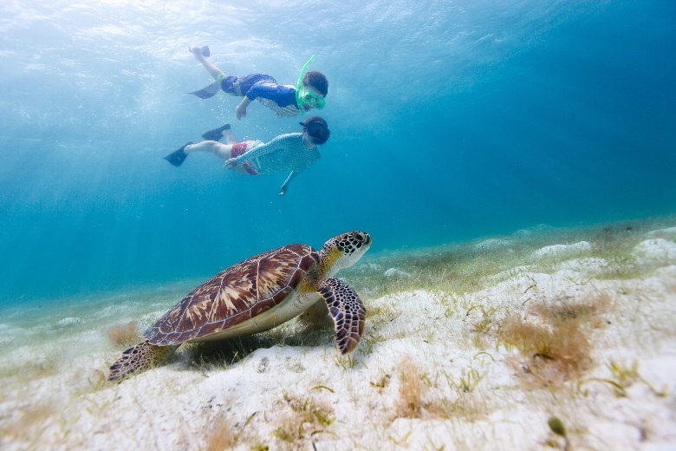
Identify tour types
Water-based tours can include:
Cruises
Boating and yachting trips
Snorkelling and scuba diving
Fishing trips
Notes:
Trainer states water-based tours include:
Cruises
Boating and yachting trips
Snorkelling
Scuba diving
Fishing tours.
Class Activity (1) – Handouts
Trainer distributes and discusses promotional/advertising material for the tour type identified on the slide.
Class Activity (2) – Excursion
Trainer arranges for students to participate in a tour type as identified on the slide.

Slide 33
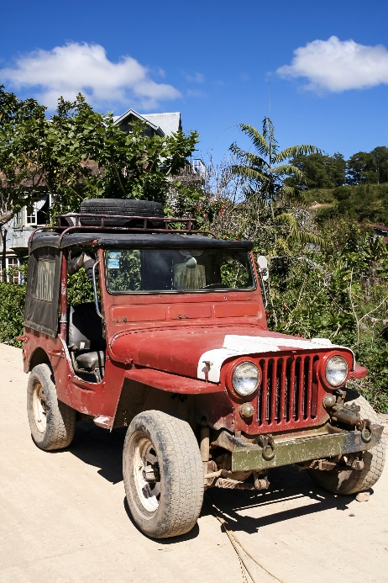
Identify tour types
Land-based tours can include:
4WD tours and remote area tours
Rail tours, bus/coach tours and bike and motor bike tours
Walking tours
Horse and camel tours
Caravan and camper tours
Notes:
Trainer presents land-based tours include:
Four-wheel drive tours
Remote area tours
Rail tours
Bus/coach tours
Bicycle and motor bike tours
Walking tours
Horse and camel
Caravan and camper tours.
Class Activity (1) – Internet Research
Trainer facilitates student research of and discussion regarding content of following and other similar/relevant websites:
http://www.affordabletours.com/search/Type/ - Different tour types at Affordable Tours.com
http://www2.amk.fi/digma.fi/www.amk.fi/opintojaksot/050809/1184649944500/1184650138999/1184654457131/1184654823506.html - Types of Tours (VirtuaaliAMK Tourism Intermediaries)
http://www.theguardian.com/travel/typesoftrip - Types of Trips (The Guardian)
http://www.jobmonkey.com/landtours/html/types_of_tours.html - Tour Guide Jobs: Types of Tours
http://psna.ru/index.php?p=ekskursovod&st=en8 – Classifications of Tours
Class Activity (2) – Handouts
Trainer distributes and discusses promotional/advertising material for the tour type identified on the slide.
Class Activity (3) – Excursion
Trainer arranges for students to participate in a tour type as identified on the slide.

Slide 34

List the characteristics of a tour guide
Characteristics of an effective Tour Guide:
Honesty
Practicality
Friendliness
(Continued)
Notes:
Trainer identifies the following are accepted as being essential characteristics for Tour Guides:
Honesty – in relation to:
Dealing with people
Handling money
Looking after people’s property
What they tell people in terms of commentary
Practicality – in terms of:
Resolving issues and solving problems
Keeping the tour on track and on schedule
Addressing problems arising
Responding to requests and being flexible
Friendliness – towards:
People of all ages
People from all countries
Those who most need it
Those who are having a bad day
Those who appear excluded from the tour

Slide 35

List the characteristics of a tour guide
Willingness to serve
Local knowledge
Excellent appearance
Appropriate range of knowledge, skills and abilities for the tour types to be led
Notes:
Trainer continues identifying essential characteristics of Tour Guides:
Willingness to serve – with reference to:
Demonstrating service as a pleasure and not a chore
Offering to help without waiting to be asked
Predicting and avoiding problems
Smiling
Asking lots of questions
Local knowledge – as it applies:
Currently – knowledge must be up-to-date
To tour destinations
To the host country
Excellent appearance – in terms of
Personal presentation
Personal hygiene
A range of skills, knowledge and abilities to conduct/lead the tour for which they have responsibility – see later slides.
Class Activity – Internet Research
Trainer facilitates student research of and discussion regarding content of following and other similar/relevant websites:
http://travelblog.viator.com/top-10-characteristics-of-a-great-tour-guide/

Slide 36

Describe tour guiding principles
Tour guiding principles may flow from:
Requirements imposed by employers
Requirements of various ‘Codes’
Standard ethical business practices
Experience and the passage of time
Notes:
Trainer notes tour guiding principles are guidelines governing how Tour Guides operate and function stating these principles govern and control the thoughts, action and speech of Tour Guides in their day-to-day working life and highlighting tour guiding principles can exist in a number of ways:
They can be requirements imposed on Tour Guides by their employer – as part of the terms and conditions of employment with a Tour Operator
They may be requirements imposed by a governing body (a government agency or a peak industry body) in the form of a Code of Conduct or similar – designed to give tourists confidence in the services provided by Tour Operators who subscribe to the Code
They can flow from standard ethical business practices – which demand honesty, accountability and integrity from all organisations regardless of the type of business they operate
They have evolved over time – in response to issues and problems encountered, feedback from tour group members, market research, common sense and action taken by other businesses in other industry types and sectors.
Class Activity – Handouts
Trainer distributes and discusses Codes and related other documents which represent/provide guidance or direction in relation to tour guiding principles.

Slide 37

Describe tour guiding principles
Tour guiding principles:
Need to ensure safety and security of tour and tour group members
Need for care and respect
(Continued)
Notes:
Trainer observes the following is indicative of what exists and provides a sound basis for the delivery of professional guiding services:
Need to ensure the safety and security
This applies to:
Tour group members
Their property
Assets of the employer
Property owned by businesses/sites and people/communities visited.
It also embraces need for:
Risk management – including risk identification and assessment, and the implementation of risk control for tours
Development of contingency plans – to address identified emergency conditions
Training to enable safe and secure operation of tours
Equipment, facilities and technology to support tour safety and security.
Need for care and respect
Which needs to be demonstrated/shown towards:
The employer
The tour group members
The host country
The sites/destinations to be visited

Slide 38

Describe tour guiding principles
Need for appropriate skills and abilities
Need for knowledge
(Continued)
Notes:
Trainer continues identifying tour guiding principles:
Need for appropriate skills and abilities
This highlights the need for Tour Guides to possess the necessary competencies to enable them to conduct/lead the tour/s for which they have responsibility
In general these can be expected to include:
Unique skills relevant to the type of tour being guided – which may (for example) include ability to drive a bus, skills in cooking, language skills as well as abilities related specifically to the type/nature of the tour such as climbing skills, white water rafting skills, animal handling skills, motor bike riding skills
Communication and interpersonal skills
Negotiation and conflict resolution skills
Planning, researching, organising and strategic thinking skills
Risk and emergency management skills
First aid skills and the ability to respond to accidents
Ability to operate basic emergency equipment and communication systems
Leadership and control skills.
Need for knowledge
Every Tour Guide must have:
Comprehensive, accurate and current knowledge of:
The host country
All areas, businesses, attractions, sites, venues and destinations to be visited on tour
Local culture, customs, language, transport, currency, services, facilities, foods
The Tour Operator and the services/tours provided
Ability to source information as required – to address questions/issues where the information is not known.

Slide 39

Describe tour guiding principles
Need to provide a positive and memorable tour
Need for ethical conduct
Need to cater for special needs of individuals and groups
Notes:
Trainer continues identifying tour guiding principles:
Need to provide a positive and memorable tour
This embraces requirements to:
Make all tours interesting and engaging
Provide a tour meeting identified needs of tour group members
Give informative commentary
Include interactive experiences
Ensure all tour group members feel included/part of the tour.
Need for ethical conduct
Which requires Tour Guides to:
Act in the best interests of the tour group
Disclose any personal interests, family connections or financial arrangements with sites, businesses or destinations visited on tour
Be honest in all dealings and statements
Never be intentionally misleading or deceitful
Obey all rules, laws, regulations and company policies
Not tout for tips/gratuities.
Need to cater for special needs individuals and groups
This requires taking appropriate action to effectively accommodate:
Visitors with language barriers/difficulties
People with physical or mental disabilities
Those with limited mobility or other sensory acuity
Certain age groups – with a focus on the very young and the very old.
Class Activity – Internet Research
Trainer facilitates student research of and discussion regarding content of following and other similar/relevant websites:
http://www.toursbylocals.com/TBL/WebObjects/ToursByLocals.woa/1/wa/textPopup?wosid=MGGNmilnEdy0tGBZHVGdbw&c=16&t=Tour+Guide+Business+Principles&s1=&s2= - Tour Guide Business Principles
http://localprivatetourguides.blogspot.com.au/2010/11/dressing-code-for-tour-guides.html - Dressing code for tour guides

Slide 40

Describe tour guiding principles
Standard protocols for dealing with special needs:
Recognise and show awareness of special needs
Explain any arrangements made to cater for them
Identify relevant facilities available
(Continued)
Notes:
Trainer identifies standard protocols for dealing with special needs participants include:
Recognise their special need to indicate awareness of it – this means verbally acknowledging/mentioning the need and how this will impact things for the visitor/tour
Explain arrangements which have been made – to accommodate those needs (where applicable): this demonstrates requests made by the group have been received and actioned and/or willingness to be of service/be accommodating of special needs
Identify the facilities available – within the site/venue/area to meet those needs, and advising these will be pointed out, implemented as and when appropriate

Slide 41
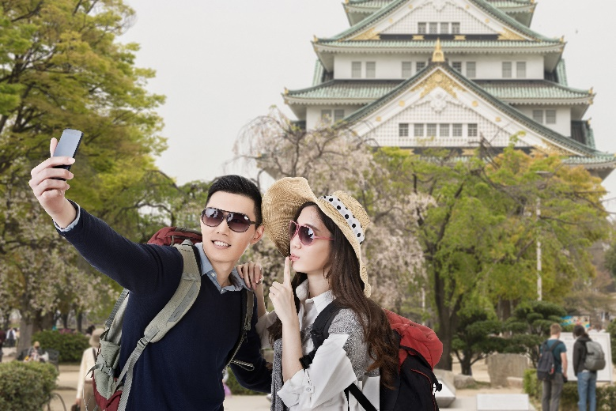
Describe tour guiding principles
Empathise with them
Be respectful
Never raise false expectations or make unrealistic promises – ‘under promise and over deliver’
Be prepared to ask for help/advice from others
Apologise where special needs cannot be meant
Notes:
Trainer continues identifying standard protocols for dealing with special needs participants include:
Empathise with their situation – without being condescending, flippant or demeaning them in front of others in the group
Be respectful and never make special needs people think they are being done a favour by meeting their special needs – or that they have created ‘extra work’
Never raise false expectations – in general terms:
Follow internal policies and procedures – to the extent of individual scope of authority
Tell them what can be done to meet their need – if anything: try/make an effort to accommodate their needs
Never over-promise what can be done – they are better off knowing right from the start if their need cannot be met
Contact management or another worker at the site/venue to determine if they can assist in meeting the special need
Apologise where a special need cannot be accommodated.

Slide 42

Summary – Element 1
When describing the context for the delivery of guiding services:
Identify the roles, functions and responsibilities of the Tour Guide as prescribed/required by the employer and tour group members
Differentiate between types of tours and tour guides
Determine the characteristics of and differences between the profiles of regular/common tour group members
(Continued)
Notes:
Trainer provides a recap of the Element asking questions to check trainee understanding and responding to questions from trainees, as required.

Slide 43

Summary – Element 1
Learn industry-related and tour-related terminology
Understand and be able to apply the interpretive approach to guiding
Demonstrate necessary characteristics of an effective Tour Guide
Identify and apply accepted/required tour guide principles
Notes:
Trainer provides a recap of the Element asking questions to check trainee understanding and responding to questions from trainees, as required.

Slide 44

Element 2 – Develop guiding skills and knowledge
Performance Criteria for this Element are:
Identify guide information sources and contacts
Acquire and up-date industry skills and knowledge
Identify legal, ethical and safety requirements that apply to provision of guiding services
Notes:
Trainer identifies for trainees the Performance Criteria for this Element, as listed on the slide.
Class Activity – General Discussion
Trainer leads a general class discussion by asking questions such as:
What sources of information for a Tour Guide do you know of/have you used?
Who do you know who could help provide advice about Tour Guide skills and knowledge?
Why is it important for Tour Guides to have up-to-date knowledge and skills?
What legal requirements are you aware of in relation to delivery of guiding services?
What ethical requirements are you aware of in relation to delivery of guiding services?
What safety requirements are you aware of in relation to delivery of guiding services?

Slide 45

Identify guide information sources and contacts
Sources of guide information:
Tour operators and wholesalers
Venue/destination operators
Industry Codes
(Continued)
Notes:
Trainer presents sources of guide information:
Tour Operators and wholesalers
These are excellent sources of:
Sample tour and travel packages; Available tour options and inclusions; Schedules; Prices; Terms and conditions; Policies and procedures;
Insight into:
Customers, visitors and tour groups; Tourist needs, wants and preferences; Experiences with groups.
Venue operators
These provide excellent information in relation to:
Promotional and advertising brochures and flyers
Opening days and times
Entry fees
Attractions, displays and events
Facilities provided
Meals/refreshments available
Location and access
Booking provisions and ticketing.
Industry Codes
These provide details and insight into ethics and practices deemed necessary/acceptable for the industry.
Class Activity – Internet Research
Trainer facilitates student research of and discussion regarding content of following and other similar/relevant websites:
http://www.wftga.org/tourist-guiding/code-guiding-practice - The code of guiding practice
http://washingtondctourguides.com/about-the-guild/code-of-ethics - Professional guide’s code of ethics and business practice
http://www.tichk.org/public/website/en/guides/code/html - Code of Conduct for Tourist Guides
http://learnline.cdu.edu.au/tourism/uluru/downloads/readings/reading20_code_of_conduct.pdf - Tour guide code of practice
http://www.cato.asn.au/About/code-of-ethics - Code of Ethics: Council of Australian Tour Operators.

Slide 46

Identify guide information sources and contacts
The internet
Industry agencies, bodies and organisations
(Continued)
Notes:
Trainer continues presenting sources of guide information:
Internet
The internet is an excellent information source but the following advice may be of use:
Never use the internet only for references/information – it is important to make direct contact with ‘real people’
Travel and tourism blogs can be worthwhile sources for gauging general client thoughts about aspects of the industry – all manner of issues are discussed including agencies and their prices and service; reliability and credibility of providers; satisfaction with carriers, destinations and attractions plus a wide range of other topics.
Create a ‘Travel’ folder under ‘Favourites’ and ‘Bookmark’ any site of interest – so useful sites can easily be re-visited
Be prepared to:
Print relevant pages/information
Follow links on pages to other sites
Take notes from the pages visited
Follow-up – take the time to (as appropriate):
Register for free updates, e-magazines, reports
Make personal contact with the organisation – to grow personal network of industry contacts.
Formal industry organisations
These can include:
Professional Tour Guide bodies and peak industry associations
Government and semi-government authorities
Licensing agencies.
Class Activity – Internet Research
Trainer facilitates student research of and discussion regarding content of following and other similar/relevant websites:
http://www.invesp.com/blog-rank/General_Travel
http://konector.com/best-blogs/best-travel-blogs
http://www.livingthedreamrtw.com/p/massive-list-of-travel-bloggers.html
http://www.thelongestwayhome.com/travel-blog-directory.html

Slide 47

Identify guide information sources and contacts
Literature
Network of personal contacts
(Continued)
Notes:
Trainer continues presenting sources of guide information:
Literature
Good sources of information are:
Guide books – such as Lonely Planet, Access, Fodor’s, National Geographic, Frommer’s; Newspaper and magazine articles; Local telephone books; History books; Reports; Travel and tour/promotional brochures.
Network of personal contacts
It is vital to develop an extensive network of personal contacts.
Those in the network could include:
A selection of Tour Guides – from different employers and who conduct a variety of different tour types
Local Tour Operators and travel agents
Carriers
Venue operators
Government officials
People at local Tourist Information centres.
It is important there is two-way communication with people in the network.
Class Activity (1) – Handouts
Trainer distributes and discusses sample literature which can be used by Tour Guides for information.
Class Activity (2) – Guest Speakers
Trainer arranges for a group of local people who may be useful ‘personal contacts’ for the students to attend and talk about their special industry knowledge.

Slide 48

Acquire and update industry skills and knowledge
Activities/opportunities to acquire and update knowledge are:
Readily available to everyone
Relatively inexpensive to access/use
Notes:
Trainer notes activities associated with acquiring and up-dating skills and knowledge are:
Readily available – there are many of them, easily accessible
Relatively inexpensive to use/access – most require an investment of time rather than large amounts of money.

Slide 49

Acquire and update industry skills and knowledge
Activities to acquire and update skills and knowledge:
Attending industry events
Partaking in some form of industry-based training or other formal training
(Continued)
Notes:
Trainer presents examples of activities to acquire and update industry skills and knowledge:
Attending industry seminars
These are advertised in the media, industry magazines and actively promoted through industry associations, websites, newsletters and direct mail
They may be held locally or elsewhere and often feature a wide array of
Exhibitors
Speakers
Products and services
There may be a need to pay to attend or they may be free of charge – there is often a need to register interest or intention to attend to facilitate catering and other arrangements
They are an excellent opportunity for:
Expanding personal networks
Learning about new products, services, packages, initiatives, deals, providers and industry issues.
Partaking in industry and related training courses
This training may be provided by:
Industry stakeholders such as carriers, providers, suppliers, key industry organisations, representative bodies and/or government organisations/authorities
Training institutions – both private and public
These courses may:
Be free or fee-for-service
Result in formal or informal outcomes – formal outcomes provide recognised/accredited qualification/s and will be formally assessed
Conducted on-site in organisations – or at some other remote location such as a training facility, supplier warehouse or government building
Feature a mix of theory and practical training
Inherent in this option is also the potential to arrange for objective evaluation and assessment of personal skill and knowledge levels to gain recognition/certification.
Class Activity – Excursion
Trainer takes students to a relevant industry event, exhibition, seminar, conference.

Slide 50
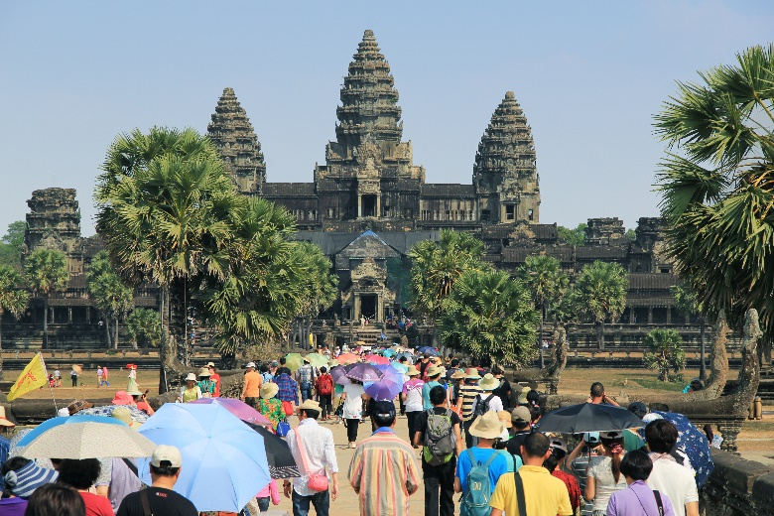
Acquire and update industry skills and knowledge
Undertaking fam tours
Joining a professional guiding association
(Continued)
Notes:
Trainer continues presenting examples of activities to acquire and update industry skills and knowledge:
Undertaking fam tours
These are commonplace within the industry
They are conducted/operated by:
Industry attractions; Venues; Sites
They are provided:
Free of charge; To industry personnel; In order to make industry personnel aware of (‘familiar with’) the destination so they will promote it/recommend it to visitors and tourists
They need to be arranged in advance for a mutually convenient time, usually by contacting the destination and making a request.
Joining a professional guiding association
It is strongly recommended all Tour Guide join at least one recognised professional guiding association
The association may be:
A local Chapter/Branch of a larger organisation
A stand-alone local body
Many Tour Guides belong to more than one such organisation
In some cases, being a member of a guiding association may be a legislated requirement where the body oversees/administers Tourist Guides licences/permits.
Class Activity (1) – Excursion
Trainer arranges for students to undertake a fam tour of one or more local attractions, venues or destinations.
Class Activity (2) – Guest Speaker
Trainer arranges for representative from local professional guiding association to attend and talk about the benefits of being a member.
Class Activity (3) – Internet Research
Trainer facilitates student research of and discussion regarding content of following and other similar/relevant websites:
http://www.wftga.org/ - World Federation of Tourist Guide Associations
http://www.seatga.org/ - South East Asia Tourist Guides Association
http://stga.com.my/ - Sabah Tourist Guides Association
http://www.societyoftouristguides.org.sg/ - Society of Tourist Guides Singapore.

Slide 51
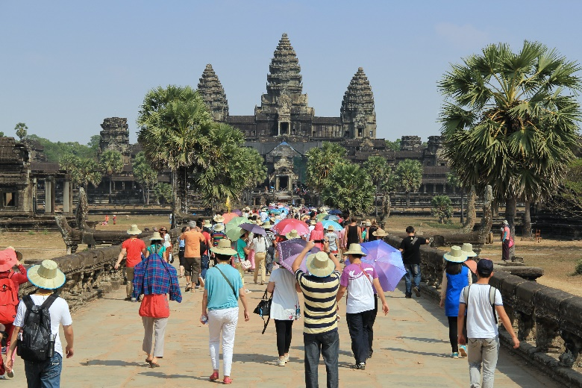
Acquire and update industry skills and knowledge
Undertaking formal and informal research
Practicing required skills
Notes:
Trainer continues presenting examples of activities to acquire and update industry skills and knowledge:
Undertaking formal and informal research
Formal research relates to:
Reading relevant text books; Undertaking formal courses of study; Reading industry reports;
Attending industry-based events
Informal research relates to:
Talking to network of contacts; Reading general media articles; Speaking with tourists/visitors;
Visiting destinations, sites and attractions.
Practicing required skills
This means implementing newly learned competencies so they become familiar and easy to perform.
It relates to the concepts of:
Drill; Repetition ; Role plays; Practical exercises; Demonstrations
The practice may:
Occur in an actual industry setting; Take place in a simulated environment; Be undertaken while acting as an assistant to another (or bona fide) tour guide.

Slide 52

Identify legal, ethical and safety requirements that apply to guiding
In regard to legal issues there is the potential for:
‘Criminal’ liability
‘Civil’ liability
Both
Notes:
Trainer advises in regard to legal issues there is a need to need to be aware of
Criminal liability
Criminal liability refers to situations where a person is found ‘guilty’ of an offence
Guilt must be proved ‘beyond reasonable doubt’
Action is taken against the person by the authorities
A guilty decision may result in:
A fine
Imprisonment
Other outcomes such as business closure, licence/permit cancelation or suspension, legally-binding directive.
Civil liability
Civil liability refers to situations where a person is found ‘liable’ in relation to an occurrence
‘Liability’ only needs to be proven ‘on the balance of probabilities’
Action is taken against the person by another person or a business for things such as:
Protecting their personal interests
Failing to take reasonable care
Breach of contract
Being found liable can result in:
Damages being awarded against the person found liable
An injunction being issues forcing them to do, or refrain from doing, certain thing/s.
Combination of the two
In some situations the same event/occurrence can give rise to:
Criminal charges
Civil action.

Slide 53
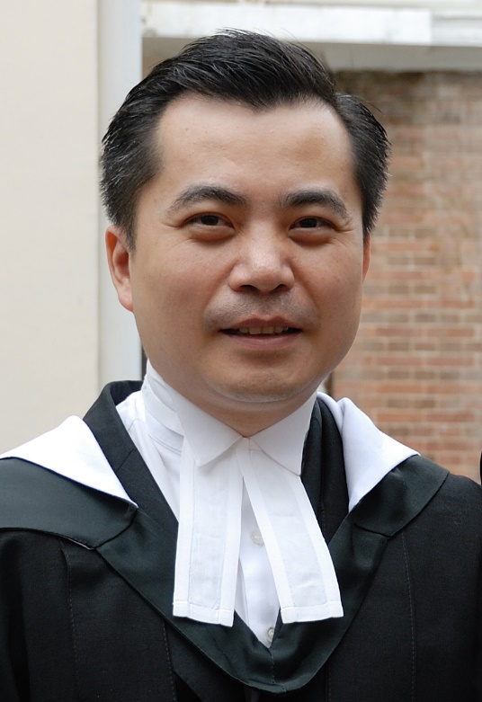
Identify legal, ethical and safety requirements that apply to guiding
Tour Guides also need to be aware of:
Duty of Care requirements under Common law
Obligations imposed by advertising
(Continued)
Notes:
Trainer further observes it is also important for Tour Guides to be aware of the following key legal issues:
Duty of care
All Tour Guides are under a common law Duty of Care liability to take ‘reasonable’ care of the people they are leading/providing guiding services to
In essence this means they must avoid causing ‘foreseeable’ harm to any tour group members
Failure to discharge this Duty of Care can result in being sued for negligence. Different types/levels of negligence exist:
Contributory negligence
Gross negligence
Vicarious liability
Comparative negligence
The various classifications of negligence help determine the penalty if found liable.
Advertising
All Tour Operators and Tour Guides are under a legal obligation to ensure their advertising complies with standard ‘fair trading’ requirements. Advertising in this context refers to:
Printed materials, promotional brochures or statements made about tours, Tour Guides (ability, experience, skills, knowledge), destinations, products, services
Verbal statement made in relation to any of the above
The basic requirement is all such claims must be truthful and honest – they must not be:
False
Misleading
Deceptive
Breaching these requirements may give rise to criminal and civil action.

Slide 54

Identify legal, ethical and safety requirements that apply to guiding
Breach of contract and the causes and possible consequences
Need to comply with all applicable legislation
Notes:
Trainer continues advising of legal issues which are important for Guides to be aware of:
Breach of contract
A contract is a legally-binding agreement which imposes rights and obligations on all parties to it. Essentially the parties agree/promise to do something, or refrain from doing something, in return for something (‘consideration’). There must be a formal ‘offer’ and ‘acceptance’ for a contract to exist
When a visitor/tourist buys a ticket they enter into a contract with the Tour Operator
They have paid money (their consideration) and the Tour Operator agrees/promises to provide an agreed tour with stated/advertised inclusions to nominated destinations subject to conditions, terms and warranties imposed by the business as part of the transaction
Where the Tour Operator or Tour Guide fails to deliver the promises the aggrieved party can choose to take a civil action for breach of contract
In Court the tourist will need to provide evidence to support their claim and the system will determine if the action/inaction was a breach of a term, condition, warranty or guarantee and make a decision based on the evidence and the seriousness of the breach
Even though the Courts may not allocate large amounts in the way of ‘damages’ many of these civil cases attract media attention which is far more damaging to the operator than the amounts awarded by the Courts.
Complying legislation
It is a standard procedure all Tour Guides comply with all relevant legislation. In practice this means they must identify and meet all requirements and regulations:
Applicable specifically to Tour Guides – where such legislation exists
Applicable in their host country
Applicable in different countries they visit/lead tours to
Applicable to all activities undertaken on tour
It is worth noting:
Employers may be vicarious liable for the actions of their staff
Employees do not have a legal defence if they commit an offence because their employer told them to break or ignore a law.
Class Activity – Handouts
Trainer distributes and discusses passages of relevant legislation Tour Guides are required to comply with.

Slide 55

Identify legal, ethical and safety requirements that apply to guiding
Standard ethical issues:
Need to be truthful and honest
Ensure products/services provided meet promises made
Demonstrate respect
Maintain principled relationships with stakeholders
Notes:
Trainer observes standard ethical issues which impact on Tour Guides include the need to:
Be truthful and honest regarding information provided to customers, including a total ban on fabrication of information
Provide products and services in accordance with advertised itinerary and promises
Demonstrate respect for local communities, local culture, sites and the environment, including the objective of minimal impact tour guiding practices aimed at sustainable operations
Maintain principled relationships with key stakeholders.
More on ethics is presented on later slides.

Slide 56

Identify legal, ethical and safety requirements that apply to guiding
Safety requirements will vary depending on:
Type of tour being conducted
Destinations, sites and venues visited
Activities, events and inclusions
Number in the tour group
Composition and characteristics of the group
Weather and local conditions
Notes:
Trainer states specific safety requirements will vary depending on:
Tour type
Destinations visited
Activities being conducted
Size of the group
Composition and characteristics of the tour group
Weather and local environmental and other conditions.

Slide 57
Identify legal, ethical and safety requirements that apply to guiding
Safety requirements may include:
Complying with legislated health, safety and welfare obligations
Ensuring responsible behaviour of tour group
Checking equipment, locations, facilities and environment
Being able to implement required emergency/risk management protocols
(Continued)
Notes:
Trainer notes examples of what may apply include:
Complying with occupational health, safety and welfare requirements – as they apply to individual tours and situations
Ensuring the responsible behaviour of customers – including:
Controlling unacceptable behaviour
Modifying unsafe behaviour
Checking equipment, locations, facilities and the environment – prior to engaging with or using same so there is full knowledge of applicable conditions/the environment
Practising implementation of prescribed emergency responses – to identified emergency situations.

Slide 58

Identify legal, ethical and safety requirements that apply to guiding
Managing risk
Removing dangerous items/activities from itinerary
Abandoning tour where/when necessary
Providing safety advice and instructions
Participating in the development of new tours contributing previous safety-related advice gained from previous experience on-tour
Notes:
Trainer continues giving examples of possible safety requirements:
Managing risk – including:
Risk identification
Risk assessment
Risk control
Explanation of potential hazards to others
Removing identified dangerous activities or undertakings from the itinerary – where necessary and (if possible) replacing them with an appropriate alternative
Abandoning the tour under conditions where the safety of customers cannot be guaranteed – and adhering to company policy regarding reimbursement of payment
Providing safety advice, directions and demonstrations to customers – including:
Monitoring of the implementation of advice
Provision of supplementary guidance as necessary
Actively participating in discussions regarding the development of new tours and itineraries and contributing personal experiences and lessons learned from previous tours.
More on safety is presented on later slides.

Slide 59
Summary – Element 2
When developing guiding skills and knowledge:
Identify relevant sources and contacts to capture guiding information
Research/use identified information sources
Be willing and prepared to update industry skills and knowledge
(Continued)
Notes:
Trainer provides a recap of the Element asking questions to check trainee understanding and responding to questions from trainees, as required.

Slide 60
Summary – Element 2
Attend industry events
Gain first-hand experiences of a variety of tours
Join industry associations
(Continued)
Notes:
Trainer provides a recap of the Element asking questions to check trainee understanding and responding to questions from trainees, as required.

Slide 61

Summary – Element 2
Practice necessary skills
Identify and apply necessary legal, ethical and safety requirements
Realise the need to guard against possible legal action which may be taken by tour group members
Notes:
Trainer provides a recap of the Element asking questions to check trainee understanding and responding to questions from trainees, as required.

Slide 62

Element 3 – Provide guiding services
Performance Criteria for this Element are:
Demonstrate the skills and knowledge necessary to guide tours
Apply required legal, ethical and safety considerations to the conduct of tours
Optimise respect for local culture
Minimise negative impact on the culture, people and environment
Notes:
Trainer identifies for trainees the Performance Criteria for this Element, as listed on the slide.
Class Activity – General Discussion
Trainer leads a general class discussion by asking questions such as:
What is involved in providing guiding services?
What experience have you had with providing guiding services?

Slide 63

Demonstrate the skills and knowledge necessary to guide tours
Skills and knowledge required can be classified into:
Pre-arrival activities
Pre-departure checks
During tour activities
Post-departure activities
Notes:
Trainer advises Tour Guide requirements can be classified into the following sections to assist with identifying and applying what is necessary:
Pre-arrival activities – concentrating on tasks to be completed before tour groups arrive for their tours
Pre-departure checks –featuring activities necessary to ensure safe and compliant operation of the tour in accordance with legal requirements and promotions
During tour activities – relating to all the duties required to lead the tour and conduct activities
Post-departure activities – focussing on administrative work required by the employer to finalise the departure of tours.

Slide 64

Demonstrate the skills and knowledge necessary to guide tours
Pre-arrival activity – Checking of arrival schedules to ensure:
Hard copy information is obtained about tours/groups
Knowledge about time and methods/ of arrival
Knowledge about the group
Understanding of issues to be clarified on their arrival
Knowledge about agreed muster point
Notes:
Trainer describes pre-arrival activities:
Checking of arrival schedules
To ensure:
Capturing hard copy information about tours and groups for the day/shift
Knowledge of times groups are arriving
Knowledge about composition of group
Knowledge about any issue/detail to be clarified and/or obtained in relation to the group/individual members of the group
Knowledge about how groups/members are arriving – public transport, private vehicle, shuttle bus
Knowledge about exactly where they will be arriving – booking office, departure lounge, outside on footpath/in car park (‘muster point’).
Class Activity – Handouts
Trainer distributes and discusses sample arrival sheets/reservation documentation used to identify tours and bookings for the shift/day.

Slide 65

Demonstrate the skills and knowledge necessary to guide tours
Pre-arrival activity – Checking reservations done to gain knowledge of:
Payments made and/or to be collected
Special needs/requests and arrangements for addressing same
Types of bookings made and what tour group members are entitled to
Seats/tickets remaining available for promotion or sale
Notes:
Trainer continues describing pre-arrival activities:
Checking reservations
To gain knowledge of:
Payments made and/or to be collected prior to departure
Special requests made by tour groups/members – and:
Tour Operator responses to these
Tour Guide commitments in this regard
Types of bookings which have been made – and how (if applicable) this impacts inclusions and/or tour guiding to be provided
Seats/tickets remaining available for sale – so action can be taken to promote and sell these.

Slide 66

Demonstrate the skills and knowledge necessary to guide tours
Pre-arrival activity – Verifying itinerary may involve:
Contacting destinations and providing to confirm arrangements
Determining weather and local conditions
Arranging suitable alternatives, if necessary
Confirming tour basics
Notes:
Trainer continues describing pre-arrival activities:
Verifying itinerary
This may involve:
Contacting destinations and providers – and confirming arrangements
Determining weather and other local conditions – and factoring this knowledge into plans
Arranging suitable alternatives – where necessary
Confirming basics of the tour – in relation to knowledge of:
Departure and arrival times
Transportation
Routes
Inclusions
Breaks and meals/refreshments
Activities.

Slide 67
Demonstrate the skills and knowledge necessary to guide tours
Pre-arrival activity – Collecting resources for the tour may require:
Obtaining and checking ‘Guide kit’
Obtaining resources/materials for distribution to tour group members
Obtaining necessary vouchers
Notes:
Trainer continues describing pre-arrival activities:
Collecting resources relevant to the tour to be conducted
This can require:
Obtaining and checking guide kit – as appropriate for the individual needs of specific tour types which will contain essential items to enable the effective and safe conduct of the tour, such as:
Maps; First aid kits; Communications devices; Pen and paper and nominated internal forms; Contact List; Tour notes and script for commentary; Prop kit
Obtaining resources and other materials for distribution to tour group members – such as:
Information brochures and Fact Sheets; Safety advice and information; Tour maps; Specific information relating to individual destinations, events, activities on tour
Obtaining necessary vouchers to reflect tour group numbers and inclusions – such as for:
Entry to venues/destinations; Meals/food and beverages; Merchandise and nominated services; Discounts on certain purchases.
Class Activity – Samples and Handouts
Trainer presents samples of items listed in slide explaining how they are checked and used by Tour Guides.

Slide 68
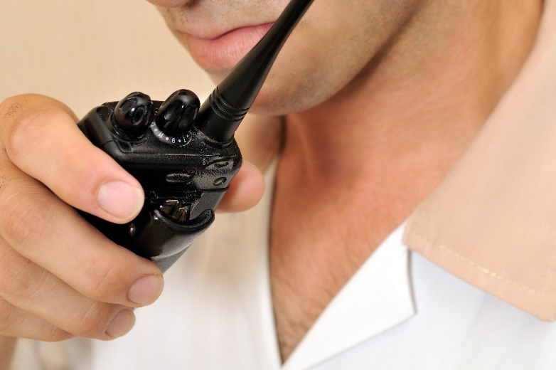
Demonstrate the skills and knowledge necessary to guide tours
Pre-arrival activity – Testing items for the tour may require:
Testing communication and presentation equipment
Testing and checking sporting equipment
Checking items to be used by tour group members to participate in scheduled activities
Notes:
Trainer continues describing pre-arrival activities:
Testing items
Which may require:
Testing communication items/devices:
Microphones on PA systems; Megaphones; Walkie-talkies/two-way radios; Cell phones; Pagers; Portable PA systems; Laser light pointers; Personal audio facilities – these are more commonly used for self-guided tours but can be used for certain portions of a longer tour – for example, the headset and player unit may be distributed to tour group members when they are given 90 minutes to wander at their leisure through the museum part of a larger site; Audio-visual equipment – where it is to be used for presentations:
PowerPoint/data projectors and screen
Overhead projectors and screen
DVD players and monitor
Movie projectors and screen
Computers – and internet connection where this will form part of the tour or a component of a presentation or tour activity
Testing/checking sporting equipment – as required for games and sporting activities to be played:
Bats, racquets and balls
Boats and cars (pedal cars, luge cars; motorised kiddies cars)
Protective clothing and equipment
Checking items required to enable tour group members to participate in scheduled activities:
Ingredients people are going to use
Utensils and items of hand-held or powered equipment.

Slide 69

Demonstrate the skills and knowledge necessary to guide tours
Pre-arrival activity – Preparing scripted commentary:
A prepared talk and guide about the tour
Does not need to cover everything which will/needs to be said
There will always be a need for unscripted commentary to supplement the scripted commentary
It takes a long time to write a good scripted commentary
Notes:
Trainer continues describing pre-arrival activities:
Preparing scripted commentaries
A scripted commentary is a prepared talk about an identified topic/topics of interest to a group of tour group members
The scripted commentary may be prepared by the agency and provided for use, or there may be a need to develop a scripted commentary for a certain tour, group and/to meet special requests/needs of a tour
A scripted commentary should be thought of as a guide about what needs to be said rather than a complete list of everything that needs to be said during a tour
There will always be a need to provide some unscripted commentary to supplement whatever scripted commentary is prepared
Unscripted commentary refers to the situation where information is provided to the tour throughout the tour but reference is not made to a script when doing so
Writing a commentary takes time – it cannot be done on-the-spot and rarely on-the-day it is required. Writing a commentary can take weeks.

Slide 70

Demonstrate the skills and knowledge necessary to guide tours
Activities involved in preparing a scripted commentary:
Research the tour
Check the advertising/promises made
Know/learn the route
Involve/get input from others
(Continued)
Notes:
Trainer presents activities involved in preparing a scripted commentary:
Research the tour – knowledge is a critical underpinning element of every effective and engaging commentary:
Research is required about what the visitors want, need and/or prefer to hear about
Research is essential about the site/location/venue where the tour will be delivered to obtain statistics (people just love figures as part of a commentary – height of things, number of things, weight of things, speed of things, temperatures, size/dimensions), history, details about the facilities, interesting facts about the area or venue, names of owners … and, of course, loads of facts/details about anything which is the main focus of the tour. For example:
If preparing a commentary for a zoo it is vital to know all there is to know about the animals, their habitat and their feeding habits
If preparing a script for an historical tour it is critical to know important dates, events, people, and sites
Check the advertising undertaken by the tour company, the site or the venue to identify topics promoted to visitors – and then ensure these are covered by the commentary in order to meet expectations and advertised promises
Know the route – the commentary will/should describe and provide information about the venue/site in general but (more so) on what is visible on the tour itself. This means a need to cover in some detail all buildings, natural and built attractions, events as the tour sees them/passes them
There is no need to cover – or cover in far less detail – buildings and similar not viewed or visited as part of the tour however there still remains a need to have knowledge about them.
Involve others – the scripting process should involve others to:
Contribute ideas
Provide information, facts and figures
Bounce ideas off
Practice on.

Slide 71

Demonstrate the skills and knowledge necessary to guide tours
Experience some other Tour Guides delivering scripted commentaries
Avoid personal opinions
Avoid inappropriate language
Prepare a draft
Trial/practice the draft by reading it out aloud
(Continued)
Notes:
Trainer continues presenting activities involved in preparing a scripted commentary:
Experience some other commentaries – before starting to develop the commentary to learn from:
What they do/say
How they do and say it
When they do and say things
The amount of commentary they provide
Avoid personal opinions, thoughts, beliefs and prejudices – a commentary is not the place to air personal views
Avoid inappropriate language – such as:
Swearing/bad language
Racist terms
Gender bias
Prepare a draft – and then revise it time and time again until it has been polished to the required standard
‘Speak’ the commentary when trialling it – it must be spoken aloud to get a proper feel of it. Simply reading it in the mind will not do it.
Read it out loud to others for their feedback/comment.
Record it and listen to it and self-critique.
Class Activity – Guest Speaker
Trainer arranges for a Tour Guide to attend and discuss the preparation of scripted commentary for a tour.

Slide 72
Demonstrate the skills and knowledge necessary to guide tours
Write from the visitor’s perspective
Use simple/plain language
Reflect the nature of the tour
(Continued)
Notes:
Trainer continues presenting activities involved in preparing a scripted commentary:
Write the script from the guest/visitor perspective – for example if at the front of a bus or tractor train and facing backwards towards the visitors, the landmarks must be identified from their viewpoint
For example, do not say “On my right is a fine example of …”, instead say ‘On your left”
Use simple, plain language – this is not to infer a need to be condescending but highlights the need to keep things simple and easy to understand
Use simple sentences, not long ones and use simple words and not complex ones
The easier a commentary is for people to understand, the more they will enjoy it, the more they will learn from it, the more they will engage with the tour and the more satisfaction they will get from the tour
Reflect the nature of the tour – for example a tour focussing on nature may be expansive and emphasise grandeur and awesome natural spectacle. A tour of prison, museum or war-related tour would take a vastly different approach and be more restrained, respectful and serious.
Class Activity – Excursion
Trainer arranges an excursion where students can hear a Tour Guide present a scripted commentary.

Slide 73
Demonstrate the skills and knowledge necessary to guide tours
Revise draft on basis of feedback and trials – be prepared to revise the revised draft
Practice final commentary prior to actual delivery – to gain confidence and familiarity with it
Notes:
Trainer continues presenting activities involved in preparing a scripted commentary:
Revise the scripted commentary – as required when things change to keep it current
Practice the commentary before using/delivering it – which means:
Reading it out aloud several times – not just once: five is a minimum
Reading it in situ – this means walking/driving the tour route and commentating to align with points of interest and items mentioned in the commentary
Bringing the standard commentary to life with personal anecdotes or knowledge as appropriate to the venue, topics or interests of the group.
Class Activity – Individual Exercise
Trainer asks students to prepare a scripted commentary to accompany an agreed tour.

Slide 74
Demonstrate the skills and knowledge necessary to guide tours
Pre-departure checks – Checking tour requirements may require talking with others to:
Confirm plans/arrangements
Discuss changes
Determine alternatives
Recap roles and responsibilities
Notes:
Trainer describes pre-departure checks:
Checking tour requirements
This requires:
Talking with other personnel (such as Tour Operator/manager, drivers, assistants, cooks) to:
Confirm plans/arrangements
Discuss imposed/necessary changes
Determine alternatives
Recap allocated roles and responsibilities.

Slide 75
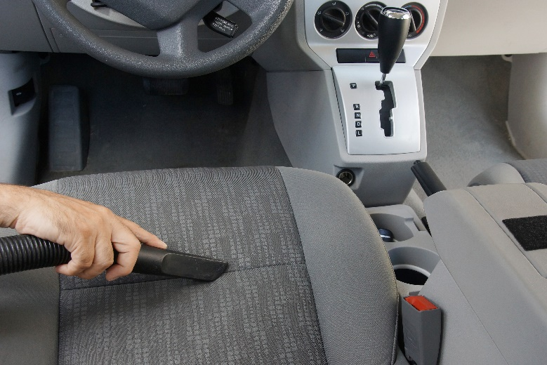
Demonstrate the skills and knowledge necessary to guide tours
Pre-departure checks – Preparing transportation may require:
Undertaking safety inspections/checks
Cleaning
Replenishment of on-board supplies
Notes:
Trainer continues describing pre-departure checks:
Preparing transportation
Which may require:
Undertaking mandatory safety checks/inspections
Cleaning
Replenishment of on-board supplies.

Slide 76
Demonstrate the skills and knowledge necessary to guide tours
Pre-departure checks – Processing tour resources may require:
Requisitioning/ordering resources
Obtaining and checking/inspecting resources provided
Loading/stowing items on board transport
Notes:
Trainer continues describing pre-departure checks:
Processing tour resources
Which can include need to:
Requisition/order resources – as required based on tour type, group, numbers and budget
Obtain and check/inspect resources provided – to ensure integrity, sufficiency, appropriateness and safety
Loading/stowing items on transport.

Slide 77

Demonstrate the skills and knowledge necessary to guide tours
Pre-departure checks – Completing documentation may relate to:
Vehicle logs
Internal tour-related paperwork
Time sheets
Tour manifests
Signing for tour items
Notes:
Trainer continues describing pre-departure checks:
Completing documentation
Which will relate to:
Vehicle/transportation documentation/logs – recording mileage, dates, driver name, destination, tour type
Internal paperwork to record resources used – by tour
Time sheets
Tour manifests
Signing for items – keys, credit cards, acknowledgement of directives/orders from management, cash advances.
Class Activity – Handouts
Trainer distributes and discusses documents identified on the slide.

Slide 78

Demonstrate the skills and knowledge necessary to guide tours
Pre-departure checks – Checking personal appearance will require attention to:
Dress and grooming standards required by employer
Standards of decency and common sense
Meeting requirements of the upcoming tour
Personal hygiene
Notes:
Trainer continues describing pre-departure checks:
Checking of personal appearance
Which will require attention to:
Standards of dress and grooming required by the employer
Standards of decency and common sense
Requirements of the tour to be conducted
Personal hygiene.
Class Activity – Excursion
Trainer arranges excursion to a tour operator so students can view pre-departure checks and activities and talk to Tour Guides about same.

Slide 79

Demonstrate the skills and knowledge necessary to guide tours
During-tour activities – Greeting tour group may require:
Being there before tourists arrive
A verbal welcome and a smile
Self-introduction
Thanks for coming
Introducing relevant others
Establishing rapport
Notes:
Trainer describes during-tour activities:
Greeting tour group/tour group members
Which requires:
Being there – it is important to be there before the advertised/promised starting time and before tourists arrive to demonstrate preparedness for their arrival
A verbal welcome – to the group and individuals
Introducing self – and role
Thanking them – for arriving/taking the tour
Smiling – the universal language
Making necessary introductions – to other tour group members and to other staff Tour Guides who will be on tour
Establishing a rapport with the group/individuals.
Class Activity – Demonstration and Practical
Trainer demonstrates greeting of tour group members and provides opportunity for students to do same.

Slide 80

Demonstrate the skills and knowledge necessary to guide tours
During-tour activities – Confirming tour details can embrace:
Providing itinerary
Distributing materials/resources
Including a Q&A session
Mentioning hazards and safety issues/requirements
Explaining tour group management protocols
Notes:
Trainer continues describing during-tour activities:
Confirming tour details
Which can embrace need to:
Verbally provide itinerary details – highlighting points of interest and special events and arrangements
Distribute materials – such as name tags, itineraries, tickets, vouchers, handouts, tour materials
Include a Q & A session – so participants have an opportunity to clarify issues, ease anxiety and obtain answers to their pressing questions/concerns
Mention potential hazards – and identify safety protocols and emergency measures which have been established
Explain tour group management protocols to ensure safety of all and no-one is separated from group or ‘lost’ on tour – covering:
Muster points
Need for everyone to check on others
Use of head counts
Provision of cell phone number for Tour Guide, driver, Tour Operator for people to use in emergency.

Slide 81
Demonstrate the skills and knowledge necessary to guide tours
During-tour activities – Commencing the tour can embrace:
Doing a head count
Leading tour group members to vehicle/transport
Explaining on-board facilities
Starting the tour ‘on time’
Notes:
Trainer continues describing during-tour activities:
Commencing the tour
Which can embrace need to:
Do a head count for the tour group – to identify/confirm ‘pax’
Lead tour group members to vehicle/bus – and assist with boarding
Explain facilities on board – and any relevant ‘rules’ relating to the transport
Start the tour on time – so it runs according to schedule: this is important:
Because destinations, sites and attractions are expecting the tour at set times
As tour group members may have made other arrangements based on the advertised finishing time of the tour
So the next tour can start on time.

Slide 82

Demonstrate the skills and knowledge necessary to guide tours
During-tour activities – Continuing relationship building and interactions with tour group members can embrace:
Extending/building on previous conversations
Asking questions
Using ‘ice breakers’
(Continued)
Notes:
Trainer continues describing during-tour activities:
Continue relationship building and interactions with tour group members
Techniques to build rapport with participants may include:
Extending/building on conversations when people were initially greeted– such as:
Remembering and using the person’s name
Mentioning something talked about as part of the previous contact
Checking to ensure something they queries earlier has been resolved to their satisfaction
Asking participants questions – about topics such as:
Their country of origin
Personal interests and specific interests for this tour
Their reasons for being on tour
Their previous experiences and tours
Using icebreakers – these are quick exercises which can be used to ‘break the ice’ and introduce tour group members to each other. They are really only suitable where:
The participants do not already know each other – if the group members already know each other then ice-breakers are often not appreciated and many resent having to participate in them
There is sufficient time to conduct them – they can be quite time consuming
A suitable, comfortable location exists to do them – standing in the heat is not a good location.
Class Activity (1) – Internet Research
Trainer facilitates student research of and discussion regarding content of following and other similar/relevant websites:
http://insight.typepad.co.uk/40_icebreakers_for_small_groups.pdf and http://training-games.com/pdf/40FreeIceBreakers.pdf
Class Activity (2) – Activity/Role Play
Trainer demonstrates how to use ice breaker activity with tour group and provides opportunity for students to do same.

Slide 83

Demonstrate the skills and knowledge necessary to guide tours
Using anecdotes
Using humour
Checking on people’s welfare
Applying appropriate interpersonal and communication skills
Involving tour group members in what is happening
Notes:
Trainer continues describing relationship building during-tour activities:
Using anecdotes when interacting with participants – these are short stories relevant to the site, location or up-coming tour and are used as they add interest and provide insight into the experience
Using humour when talking with people – most tours contain an element of fun and the use of appropriate humour at appropriate times can set the scene for fun and actually impart fun and enjoyment before the tour starts
Checking on people’s welfare – by asking if they need anything, verifying they are OK and prepared, and helping them solve their problems
Applying suitable interpersonal and communication skills at every opportunity/exchange – such as:
Smiling; Eye contact; Demonstrating interest; Responding to questions; Clarifying information
Involving them in what is happening – this can include:
Telling them what is about to happen; Giving them something to do – this may even extend to giving them a simple task to assist (depending on nature of tour and organisational policies);
Giving them something to look at/read.

Slide 84

Demonstrate the skills and knowledge necessary to guide tours
During-tour activities – Providing commentary can include:
Ensuring visibility to best extent possible
Facing the group
Speaking loudly enough or using PA
Being enthusiastic
(Continued)
Notes:
Trainer continues describing during-tour activities:
Providing commentary
Basic communication strategies which can/should be used to deliver commentaries may include:
Ensuring visibility to all tour group members – it is preferable if all people on the tour can also read/see lips but at a minimum they should at least be able to see the person speaking to some extent
Facing the group – to the greatest extent possible
Speaking loudly enough for everyone to hear – or using technology to help project the voice
Remaining enthusiastic and appropriate for the tour content – and as appropriate to the nature/profile of the tour group members: some tours/topics require a sombre approach and others a lively and engaging demeanour.

Slide 85
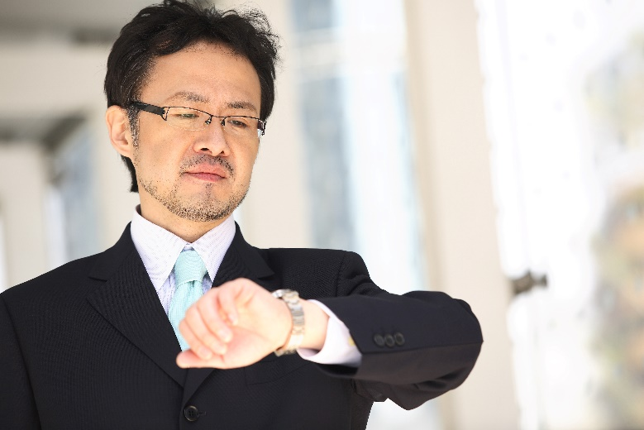
Demonstrate the skills and knowledge necessary to guide tours
Timing delivery properly according to travel and destinations/attractions
Focussing attention on everyone in the group
Communicating at a level/in a way so commentary will be understood by everyone
(Continued)
Notes:
Trainer continues describing providing commentary during-tour activities:
Beginning the verbal commentary sufficiently in advance of a scheduled tour stop so participants have time to focus on whatever is the focus of the commentary
Alternatively a decision may be taken to arrive at the stop, and then deliver all the commentary at this point
Focussing attention on entire group – the commentary must be directed at, and embrace, all the tour group members
Never fall for the common traps of:
Talking only to those who are closest
Directing commentary at those in the immediate line-of-sight
Commentating only to one or two ‘special’ group members
Focussing on a certain person, age group, nationality or gender
Communicating at level that will be understood by the audience considering their age, education, language, culture and special needs – this frequently means:
Keeping things simple
Using hand gestures to accompany verbal communication
Using appropriate words, terms and phrases
Highlighting points identified as being of interest to the group.

Slide 86

Demonstrate the skills and knowledge necessary to guide tours
Seeking feedback from the tour group
Encouraging questions
Making the commentary ‘unique’
Knowing when to be quiet
Adjusting commentary as required
Notes:
Trainer continues describing providing commentary during-tour activities:
Seeking feedback from the group throughout the commentary:
Can they hear/see?
Anything else they want to know?
Do they want a break/rest?
Encouraging questions – and responding to them in a way which demonstrates questions really are encouraged and appreciated
Making the commentary a ‘unique’ event – avoid allowing commentaries to:
Become boring and lifeless
Sound rote and mechanised/robotic
Adding comments which include new information and target the interests of the group
Knowing when to be quiet – many people who deliver tours seem to think their job is to talk ‘all the time’ and this is definitely not the case/requirement. It is important to keep quiet to allow participants to:
Have a break from being talked at/to
Experience the tour in relative peace and quiet
Enjoy the experience on their own
Adjusting the commentary as required – to accommodate:
Identified interest of the group
Emerging events.

Slide 87
Demonstrate the skills and knowledge necessary to guide tours
During-tour activities – Using correct protocols when using communication equipment:
Keeping communication lines open/free
Using designated channels
Using established protocols
Knowing emergency transmission words
Checking-in as required
(Continued)
Notes:
Trainer continues describing during-tour activities:
Using correct protocols when using communication equipment on tour
It is common for the following to be standard procedures regarding the use of radios and communication when leading a tour group:
Keeping communication lines clear unless addressing urgent issues
Using designated channels for communication
Using established protocols for:
Responding to a transmission
Sending a transmission
Spelling out a name – using the phonetic alphabet (see following slides)
Knowing emergency transmission words that will give the message priority – ‘Urgent’, or ‘No duff’
Checking-in as required - at designated times, after completion of designated activities/events, when arriving at a designated location.
Class Activity – Demonstration and Practical
Trainer demonstrates how to use an assortment of communication equipment and gives students an opportunity to do same.

Slide 88
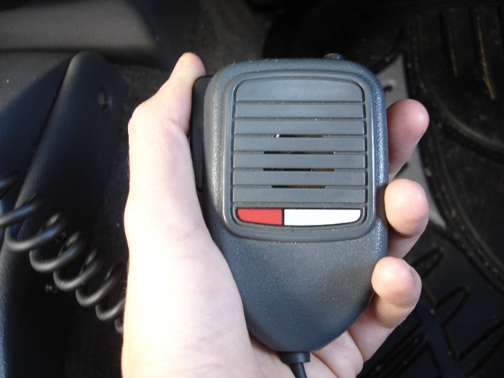
Demonstrate the skills and knowledge necessary to guide tours
Not talking over other transmissions
Using ‘over’ at end of communications
Using ‘go ahead’ to indicate readiness to receive
Identifying self when sending
Using appropriate language
Not mentioning ‘sensitive’ issues
Notes:
Trainer continues describing communication protocols as part of during-tour activities:
Ensuring transmissions do not talk over other transmissions
Using ‘over’ at the end of each sent transmission
Using ‘go ahead’ to indicate readiness to receive
Identifying self clearly at the start of any transmission sequence – ‘Control, this is Lily, over’
Refraining from swearing or bad language when communicating
Not mentioning matters ‘over the air’ which are sensitive in nature or which could cause panic if heard by a third party.
Class Activity – Handout and Exercise
Trainer distributes copy of Phonetic alphabet (as contained in Trainee Manual) and asks students to practice by:
Spelling out their name and date of birth using the Phonetic alphabet
Spelling out the name of their home town and country.

Slide 89
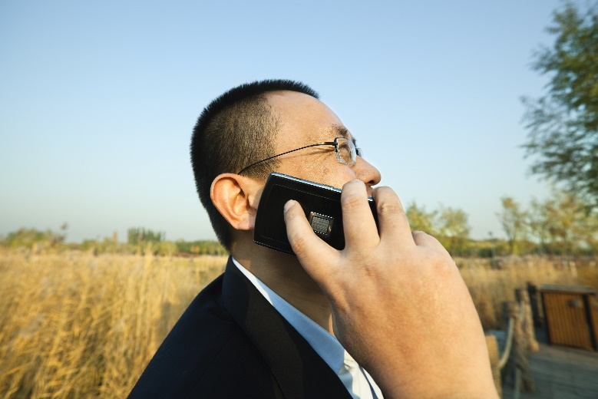
Demonstrate the skills and knowledge necessary to guide tours
During-tour activities – Using appropriate communication techniques:
Repeating aspects of commentary as/if/when required
Paraphrasing
Speaking at a variety of paces
Pointing and using hand gestures
Involving the group
(Continued)
Notes:
Trainer continues describing during-tour activities:
Using appropriate communication techniques
In relation to delivering a commentary the following are useful communication techniques:
Repeating parts of the commentary – to give those who did not hear the opportunity to listen to what was said
Paraphrasing when there is a lack of understanding – this means repeating what was originally said but using different terms/words
Speaking at a different pace – to match the requirements of the participants and/or their stated needs
Using plenty of pointing and hand gestures – to indicate what is being commented on and to provide guidance and direction
Involving the group – ask them questions; seek their feedback; talk about their feelings and what they are experiencing.
Class Activity – Demonstration/s
Trainer demonstrates application of relevant points as identified on the slide.

Slide 90

Demonstrate the skills and knowledge necessary to guide tours
Being constantly alert to communication barriers
Checking for understanding
Altering volume as required
Using extra staff
Addressing emotional barriers/issues
Notes:
Trainer continues describing communication techniques for use as part of during-tour activities:
Being constantly alert to barriers to communications – and proactively seek to avoid or address them: common barriers are noise and line-of-sight obstacles
Checking for understanding of what was said – options include:
Asking “Did everyone/you understand?”
Being alert to quizzical expressions and looks of bewilderment
Listing for comments from participants “What did he say?”
Increasing the volume of public address and communication technologies – where there is extra noise, the group is larger than normal or they say they are having trouble hearing
Using extra staff – to assist with delivering the commentary to a bigger than normal group
Addressing emotional barriers (distress, pain, intra-group conflict, conflicting personalities) before continuing with commentary.
Class Activity – Demonstration/s
Trainer demonstrates application of relevant points as identified on the slide.

Slide 91

Demonstrate the skills and knowledge necessary to guide tours
During-tour activities – Conducting hands-on activities:
Understand all there is to know
Make sure management approval exists
Verify support staff are present and ready
Arrive ‘on time’ for the activity
(Continued)
Notes:
Trainer continues describing during-tour activities:
Conducting hands-on activities
For a hands-on activity for the group, points to note are:
Understand all there is to know about the activity – and have some degree of mastery so a useful demonstration can be conducted.
All activities should have been trialled before tour group members are exposed to them
Double-check to ensure management have approved the activity for use – sight the signed approval documentation
Ensure a check is made before the group arrives that any staff involved in the activity are present and ready to help/participate
Deliver the preceding parts of the tour so group arrives at the activity site at the time agreed/arranged with support staff.

Slide 92
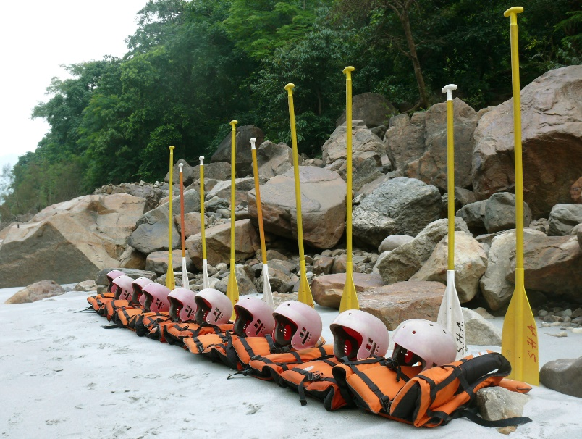
Demonstrate the skills and knowledge necessary to guide tours
Do a briefing for the activity
Advise of duration
Ensure safety has been addressed
Distribute necessary gear, resources, equipment
Explain use of resources/materials
(Continued)
Notes:
Trainer continues describing conducting hands-on activities as part of during-tour activities:
Conduct a briefing for the activity
Tell people how long the activity lasts for and when the group has to depart the activity location
Ensure all safety aspects are covered – explain any rules which may apply
Hand out safety gear, clothing and equipment – of required: demonstrate how to use it and assist participants to wear/become familiar with it
Distribute and explain the use of equipment, props, tools, equipment as appropriate.

Slide 93
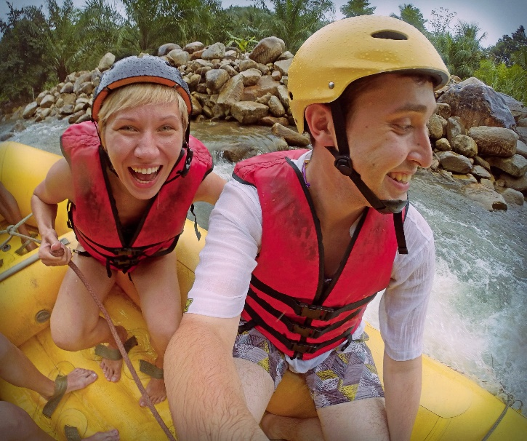
Demonstrate the skills and knowledge necessary to guide tours
Provide a demonstration to show ‘how to do it’
Follow designated safety and other protocols
Be ready to ‘stop’ the activity if necessary
Check suitability of people to participate
Notes:
Trainer continues describing conducting hands-on activities as part of during-tour activities:
Provide a demonstration – show people how to undertake the activity – give them tips and ‘inside knowledge’/hints about how to succeed, score, achieve the required outcome
People should leave all activities feeling good about themselves, not feeling they are a ‘loser’ or incompetent
Only allow the activity to occur in accordance with pre-prepared guidelines and within established parameters – this highlights the need to monitor and supervise all visitor action/attempts and provide assistance or corrective advice where needed
Always be ready to stop the activity – or intervene – if it is believed someone is in danger or a dangerous situation has arisen
Check the suitability of people to participate – it is a fact of life some tour group members will not be able to undertake some activities due to health or age reasons.
Be tactful when needing to exclude someone from an activity and try to have a substitute available.

Slide 94
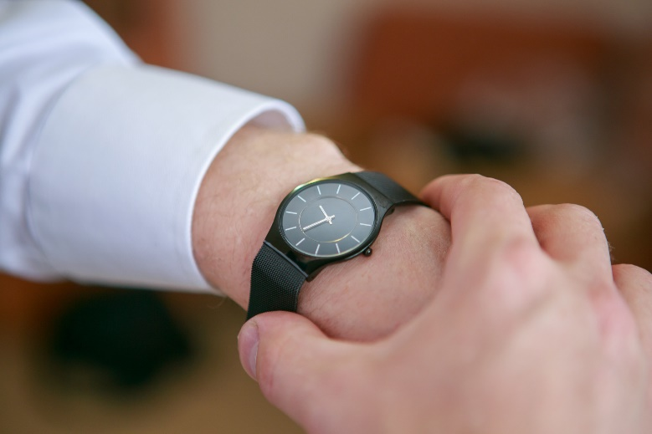
Demonstrate the skills and knowledge necessary to guide tours
Limit participation as/if necessary
Help people engage/participate
Encourage people
Keep track of time
Congratulate participants
Notes:
Trainer continues describing conducting hands-on activities as part of during-tour activities:
Limit participation to established ‘maximum numbers’ only – where necessary restrict/control the number of tour group members who can participate at any one time
Help people as necessary – be proactive but realise many people like to find their own way thorough new challenges and work things out for themselves: never impose help or force people to accept it
Encourage people as they participate – and recognise competency and effort
Keep track of time – notify people of the up-coming end of the activity so the conclusion of the activity does not come unannounced: finish the activity on time so the tour can resume on time according to the itinerary/schedule
Congratulate participants – and share their excitement and experiences.
Class Activity – Demonstration/s
Trainer demonstrates application of relevant points as identified on the slide.

Slide 95
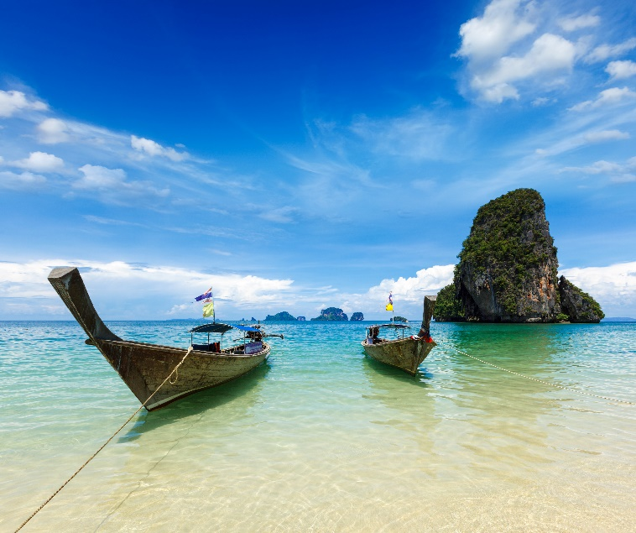
Demonstrate the skills and knowledge necessary to guide tours
During-tour activities – Monitoring group and assessing their needs:
Point out local facilities
Select suitable sites for activities/commentary
Keep group informed
Keep group together
(Continued)
Notes:
Trainer continues describing during-tour activities:
Monitoring group and assessing their needs
Tour Guides should pay attention to the following:
Pointing out nearby washroom and rest room facilities – so people can use the toilet or freshen up
Selecting suitable sites for delivering information, commentary or responding to questions or requests – such as a shady or dry spot, or one protected from the wind
Verbally informing people how long (in terms of distance and/or time) until the next stop, site, refreshment stop
Keeping the group together, physically – and not allowing stragglers.
Class Activity – Demonstration/s
Trainer demonstrates application of relevant points as identified on the slide.

Slide 96

Demonstrate the skills and knowledge necessary to guide tours
Address problems between tour group members – never ignore these issues
Be prepared to ask people to modify their language or behaviour where/if necessary
Notes:
Trainer continues describing monitoring group and assessing their needs as part of during-tour activities:
Addressing problems between members of the group – there can be situations where friction exists between members of a tour group and this manifests itself in ways which threaten the harmony and cohesiveness of the group
Asking people to modify their behaviour and/or language – where, for example, their actions are:
Culturally insensitive
Socially unacceptable
Illegal
Threatening or intimidating to others
Causing anxiety, distress or ill-feeling within the group.
Class Activity – Demonstration/s
Trainer demonstrates application of relevant points as identified on the slide.

Slide 97

Demonstrate the skills and knowledge necessary to guide tours
During-tour activities – Maintaining tour group interest:
Demonstrating personal passion
Tailoring information to the group
Using a prop kit
Varying approaches
Highlighting the unexpected
Interacting with tour group members
(Continued)
Notes:
Trainer continues describing during-tour activities:
Maintaining tour group member interest
Options for maintaining interest of people on a tour include:
Demonstrating personal passion – see following slides
Tailoring information to the identified needs of the group – while the prepared commentary will/should have done this, it is also essential to do this with ‘issues arising’ throughout the tour such as:
In response to questions; When unexpected events and sights arise
Using a prop kit – for activities and points of interest to add action, excitement, interest and flavour.
Always consider including props which can be given to, and used by, tour group participants as a way of involving and including them
Using variety of approaches – this means ‘mixing it up when providing the commentary through the use of:
Humour; Statistics; Questions; Personal anecdotes and experiences
Highlighting unexpected occurrences and including them in the commentary – and integrating them into the prepared commentary
Interacting with tour group members – through personal exchanges and questions, sharing experiences and feelings: many complaints about a tour guide relate to their failure to mix with people, talk to/with them, and/or to demonstrate engagement with them
Class Activity – Demonstration/s
Trainer demonstrates application of relevant points as identified on the slide.

Slide 98

Demonstrate the skills and knowledge necessary to guide tours
Improvising the commentary
Doing whatever it takes to deliver outstanding service
Demonstrating an interest in the tour group members and their history and experience/s
Notes:
Trainer continues describing maintaining interest as part of during-tour activities:
Improvising the commentary – by incorporating topics of current interest to the group as identified through interaction with them
This highlights the need to develop the ability to ‘think on your feet’ and adjust commentaries ‘on the fly’ to accommodate issues and preferences arising during the tour
Striving to deliver excellent service at all times regardless of the problems or situations which present themselves – this involves:
Turning negative circumstances into positive demonstrations of good service, wherever possible
Asking people to do things, rather than telling them
Smiling
Treating tour group members as individuals and not as a ‘herd’
Responding to requests where possible – and explaining why not when requests cannot be met
Being polite and courteous
Keeping promises made about the tour – such as the route, activities, inclusions and duration
Providing relevant, accurate, timely and informative commentary and comments
Keeping tour group members informed about the need to change planned/schedules activities – explaining the reasons why and (where possible) substituting a suitable alternative
Demonstrating interest in tour group members – and their past, current and future experiences: where they have been, what they are doing now and where they are going and what they will be doing tomorrow/next week.
Class Activity – Demonstration/s
Trainer demonstrates application of relevant points as identified on the slide.

Slide 99

Demonstrate the skills and knowledge necessary to guide tours
During-tour activities – Accommodating needs and wishes of the group acknowledging people may require:
Quiet time
Free time
Time to chat
Time to enjoy the site/experience
A rest
(Continued)
Notes:
Trainer continues describing during-tour activities:
Accommodating needs and wishes of the group
Considering the needs and wishes of participants may include allowing for:
Quiet time – to allow people time to relax and savour a view or experience
Free time – for tour group members to do their own thing: most tour group members will want some time to do what they want as opposed to doing what has been organised for them
A time for people to chat – this may involve chatting amongst themselves, chatting with other people they meet on the tour (locals, shop keepers, other venue staff) or chatting with their Tour Guide
Personal enjoyment of site – this is time enabling tour group members to enjoy the tour as best suits them, rather than as imposed by the tour schedule/itinerary
Some people will prefer a passive orientation where they simply watch and listen while other will want a more active approach where they want to interact with people and activities
Tour group members to have a rest – it is important to monitor the group regarding rest breaks and vital to understand the Tour Guide’s level of fitness does not dictate the requirements participants have to rest and recuperate

Slide 100
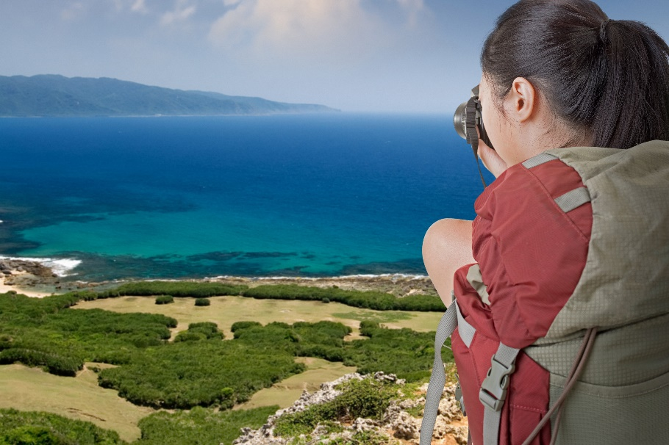
Demonstrate the skills and knowledge necessary to guide tours
Photo opportunities
‘Up close and personal’ opportunities
Preferential treatment
Notes:
Trainer continues addressing accommodating needs and wishes of group as part of during-tour activities:
Photo opportunities – always be alert to the need for people to take photographs to record their experience. Many of these ‘photo opportunities’ are predictable and will remain the same for every tour but there are always unique moments which can arise where people wish to capture the moment. Not being able to take photographs to suit individual need is a major source of complaint/dissatisfaction so be aware of the need to facilitate this. Be prepared, for example to:
Allow extra time where everyone is taking photographs – if there is a need to save time to keep the tour on schedule try to save it somewhere else and not at the expense of restricting photos taken by the group
Offer to take photographs for individuals – so they can be ‘in the photo’
Be part of the photo – many people will want their Tour Guide to be part of their photograph
Assist with the photo – be holding bags and other items
‘Up close and personal’ opportunities – tour group members expect many things of those who deliver tours and one of their main expectations is the presence of a Tour Guide will gain them access to things which are not available to people who are not on a tour. This means they may request:
A meeting with other staff/people at the site or venue
Access to areas which are ‘off limits’ to other people/those who are not part of a tour
Introductions to and/or more contact (effectively, more time) with people/other staff who are available – so they can talk more with the, ask them questions and/or watch them at work
Special photo opportunities with (for example) animals, characters or unique sights
Preferential treatment – this often relates to ‘small things’ but things which are important to the tour group members, such as:
Being served first when meals are taken – as opposed to having to queue in line with the general public
Being able to sit together for meals/refreshments – as opposed to having to take whatever seats are available
Being given the ‘best’ seats’ when dining – seats with the best view, least disruption by pedestrian traffic
Going to the front of lines/queues for rides, activities, displays, events etc
Being loaded first onto transport so they can ‘sit with each other’ and get the ‘best seats’.

Slide 101

Demonstrate the skills and knowledge necessary to guide tours
During-tour activities – Counting participants techniques:
Confirm starting numbers
Update manifest if customers elect to leave the tour
Do regular head counts at designated times/points
Physically count people
(Continued)
Notes:
Trainer continues describing during-tour activities:
Counting participants
Techniques to assist with counting tour group members include:
Being certain of the starting number when the tour departed – as this is the reference point for the checks
Updating records (manifests, passenger list) if a person notifies they are electing to quit the tour – tour group members usually have the right to leave a tour whenever they want to. The fact they have started the tour does not compel or obligate them to finish it.
Doing a physical head count of participants when the group arrives at a pre-determined head count point – this can involve:
Physically counting people as they stand or sit.
Class Activity – Demonstration/s
Trainer demonstrates application of relevant points as identified on the slide.

Slide 102

Demonstrate the skills and knowledge necessary to guide tours
Using roll calls
Checking numbers as people board
Counting filled seats after re-boarding
Asking tour group members to help
Recording the counts/checks
Notes:
Trainer continues describing counting participants as part of during-tour activities:
Asking people to respond to a roll call using the manifest or passenger list as the basis
Standing by the entry door of a vehicle and checking people as they re-board after a visiting/viewing experience – and ticking them off against the manifest
Counting the number of seats filled on the bus when people have re-boarded – 45 participants should equate to 45 seats filled
Asking tour group members a question “Is everyone here? Can you please check to see we are all here.” – this:
Is an extremely effective approach
Should be accompanied by a supplementary check
Always recording the count to demonstrate ‘due diligence’ – recording:
Pax
Time
Location.
Class Activity – Demonstration/s
Trainer demonstrates application of relevant points as identified on the slide.

Slide 103

Demonstrate the skills and knowledge necessary to guide tours
During-tour activities – Responding to missing persons:
Halt tour
Do a re-count
Identify numbers/persons missing
Notify head office
(Continued)
Notes:
Trainer continues describing during-tour activities:
Implementing company policies when tour group members are unaccounted for
Company policies will commonly require action covering several of the following points:
Halt the tour
Conduct a re-count
Identify number of people missing and names of same
Notify management, head office, site supervisor, the control room or security staff – and advise of the situation identifying:
Number/s missing
Names of those missing
Location
Time missing person was identified
Checks to-date to confirm absence of person/s.

Slide 104

Demonstrate the skills and knowledge necessary to guide tours
Ask others to stay put
Conduct a brief search of the area
Take charge
Question other tour group members
(Continued)
Notes:
Trainer continues describing implementation protocols in response to missing person as part of during-tour activities:
Request other tour group members not to move/move away – this is to:
Ensure a bad situation does not get worse by having more people wander off/go missing
Allow access to them so they may be questioned
Where necessary distribute drinks/refreshments – always try to make the sure people as comfortable as possible
Conduct a brief search of the immediate area – call out to the missing person/use megaphone: do not involve other tour group members in the search
Take charge of the situation– show confidence and demonstrate action to retrieve/resolve the situation
Ask other participants if they know where missing person is – ask the group using PA and/or move among group asking people face-to-face
A general question to the group can be effective “Does anyone know where David is?”, or “When was the last time anyone saw Cindy?”

Slide 105

Demonstrate the skills and knowledge necessary to guide tours
Confirm group numbers
Confirm receipts
Do not allow other tour members to look for the missing person
Prepare known details of missing person to assist others/authorities in their efforts to search
Notes:
Trainer continues describing implementation protocols in response to missing person as part of during-tour activities:
Confirm tour group numbers with group leader – this is really a double-check to make sure the initial count of the group was not incorrect
It is always wise to verify a belief someone is missing is supported by others
Confirm tour receipts with participants – to clarify those who are still with the tour – this, too, is a double-check to identify who is missing
Do not allow other tour group members to go looking for the missing person/s
This risks losing more members and may place them at risk. It is the job of the Tour Operator or leader to conduct and/or arrange search and recovery activities
Prepare details of the missing person/s for hand-over to other staff and/or the authorities – this may include:
Details from the manifest
Photo ID
CCTV footage of group arriving at main departure point – where applicable
Details about the person obtained from the group leader and/or other tour group members (such as those who were sitting next to them; those who shared activities with them; people who were in the same boat/car when they went on a ride) – for example, medical needs/conditions .

Slide 106

Demonstrate the skills and knowledge necessary to guide tours
During-tour activities – Handling problems with tour group members:
Realise no problems ever resolve themselves
Ensure all identified issues are addressed
Treat people with respect
Stay calm
(Continued)
Notes:
Trainer continues describing during-tour activities:
Handling problems with tour group members
Tips include:
Realise no problem will ever resolve itself – problems require action to fix/address them
Take responsibility for taking action – it is part of the job to do so
All identified issues must be addressed – never simply ignore a problem
If appropriate/possible, look for ‘safety angle’ on which to focus the conversation to be had with those creating/causing a problem or issue
People are more likely to listen and comply if it can be demonstrated they need to alter what they are doing because it is unsafe or poses a risk to others
Treat people with respect – talk politely with them allow them their dignity
Aim to make the other person feel special, not to feel victimised
Talk with people who need to be spoken to away from others in order to respect their right not to be embarrassed or challenged in front of others
Try to stay calm – when a need to intervene and say something to a participant arises.
‘Act’ but do not ‘over-react’
Avoid using a loud voice and try to speak so the conversation is private, and so the participant/s do not feel as if they are being reprimanded in front of the rest of the group and being made to look silly or ‘small’
Class Activity – Demonstration/s and Role Play
Trainer demonstrates application of relevant points as identified on the slide and provides opportunity for students to do same.
.

Slide 107

Demonstrate the skills and knowledge necessary to guide tours
Avoid personal attacks
Make ‘requests’ rather than give ‘orders’
See things through the eyes of those on the tour
Notes:
Trainer continues describing ways to handle problems with tour group members as part of during-tour activities:
Phrase what is said so it is not a personal ‘attack’ on the other person – for example, instead of saying “You must not do that”, re-phrase the statement to “We prefer such action does not take place while here/on tour/in this location”
Try phrasing statements asking people to modify their behaviour as ‘requests’ rather than ‘commands’
Give reasons why the request is being made
There is big difference between ‘Stop doing that’ and “Could I please ask you not to do that because it scares the animals?”
Look through the eyes of the tour group member and try to see things from their perspective
For example, consider saying “I can see you are tired and I know we have walked quite a long way and it is hot, but I need you to know it is not acceptable for the safety of others for you to wander off on your own to have a rest”.
Class Activity – Demonstration/s and Role Play
Trainer demonstrates application of relevant points as identified on the slide and provides opportunity for students to do same.

Slide 108

Demonstrate the skills and knowledge necessary to guide tours
During-tour activities – Dealing with problems between group members:
Speak to those involved ‘in private’
Resolve the cause on a long trip
Address the symptom on a short tour
Seek input from the parties involved
Explain how they are impacting others
(Continued)
Notes:
Trainer continues describing during-tour activities:
Dealing with problems between group members
Ask the two parties to come to one side and talk – it is important everything said when addressing issues involving two parties is spoken in front of both parties so there can be no suspicion/question over what is said
Where the tour is long one, attention should be paid to trying to resolve the root cause of the issue – where the tour is a short one, attention should focus on developing a solution to effectively address the problem until the tour has finished
Ask the parties what the problem is – this allows insight and also allows the parties to get things off their chest
Explain how their behaviour is adversely impacting the enjoyment of other tour group members.
Class Activity – Demonstration/s and Role Play
Trainer demonstrates application of relevant points as identified on the slide and provides opportunity for students to do same.

Slide 109

Demonstrate the skills and knowledge necessary to guide tours
Request no further disruption/unacceptable action
Suggest solutions – re-seat or re-group people
Monitor the situation and be ready to repeat/reinforce what has already been said
Notes:
Trainer continues describing ways to deal with problems between group members as part of during-tour activities:
Ask them to refrain from further action which disrupts the tour – and thank them for their cooperation
Be prepared to suggest solution as to assist resolve the issue in the immediate short-term, such as:
Re-seating people to different locations (for example, on the coach) so they are not near to each other, or are out of line-of-sight of the other person/party
Asking parents to more closely supervise their children
Re-grouping participants into different configurations so those having problems with another person/group in conflict are in different sub-groups when it comes to things such as viewing, activities, dining
Monitoring the situation – and being prepared to:
Repeat previous requests – it is naïve to believe people will modify their behaviour just because they have been asked once to do so
Suggest alternative solutions to issues – and allow them to choose their preferred option
Thank people for their cooperation.
Class Activity – Demonstration/s
Trainer demonstrates application of relevant points as identified on the slide.

Slide 110
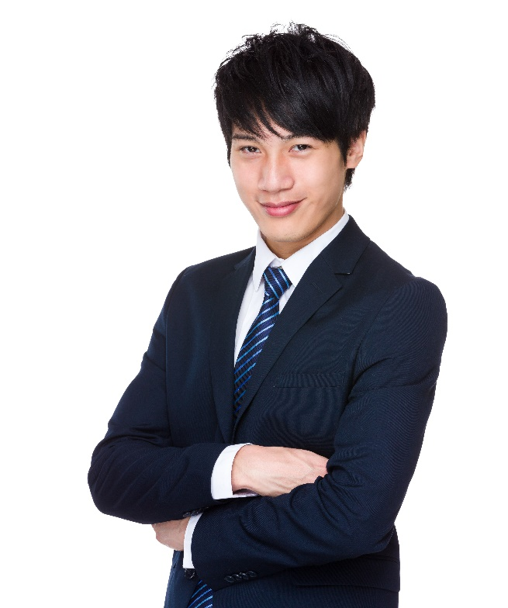
Demonstrate the skills and knowledge necessary to guide tours
On-departure/post-tour activities – Farewelling people may involve:
Thanking them and saying goodbye
Expressing hope they enjoyed the tour
Encouraging repeat business and handing out promotional literature
Advising of upcoming events/specials
Inviting them to tell others about the tour
Distributing merchandise
Notes:
Trainer describes on-departure/post-tour activities:
Farewelling tour group members
At the end of the tour:
Thank them for taking the tour
Provide a farewell wish
Express hope they enjoyed the tour/experience
Encourage repeat tours
Notify them of upcoming events and specials
Handout promotional literature
Invite them to tell others about the tour
Distribute merchandise/product as required on departure of tour group members.
Class Activity – Demonstration/s and Role Play
Trainer demonstrates application of relevant points as identified on the slide and provides opportunity for students to do same.

Slide 111

Demonstrate the skills and knowledge necessary to guide tours
On-departure/post-tour – Capturing feedback may require:
Distributing and encouraging completion of forms
Mentioning online feedback options
Talking to people
Asking for ideas/insights and complaints
Thanking people
Notes:
Trainer continues describing on-departure/post-tour activities:
Capturing feedback
This may require:
Distributing feedback forms
Encouraging completion of Customer Comment Cards
Mentioning online feedback options
Talking to people about their tour and experience
Seeking contributions for improvements and changes to the tour
Asking if people have complaints
Actively soliciting feedback and listening to and recording responses
Thanking people for their input/feedback.

Slide 112
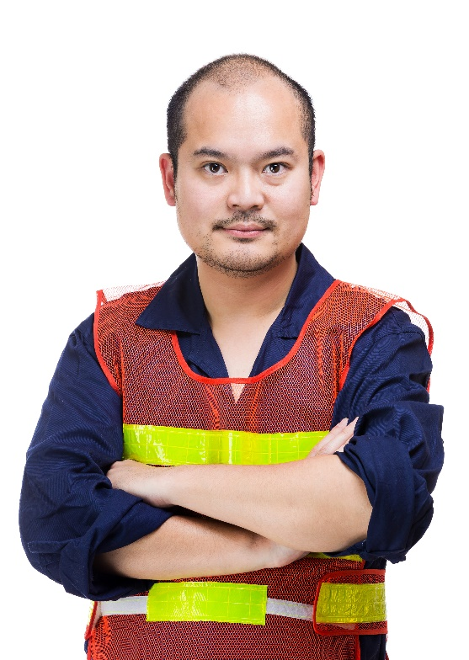
Demonstrate the skills and knowledge necessary to guide tours
On-departure/post-tour activities – Thanking people:
Group leaders
Transport drivers and catering staff
Co-workers and co-hosts
Safety and security officers
Monitors and observers
Park characters
Section guides
Notes:
Trainer continues describing on-departure/post-tour activities:
Thanking all relevant people
This may require thanking:
Group leaders
Transport drivers
Catering staff
Co-workers – who did the many things which combine to provide a memorable and effective tour, such as:
Co-hosts/tour guides
Safety officers and Security staff
Monitors and observers – for rides and activities
Park characters
Section guides – specialists in certain areas who deliver information, activities and demonstrations in their particular area of expertise.

Slide 113

Demonstrate the skills and knowledge necessary to guide tours
On-departure/post-tour activities – Completing end-of-tour activities:
Signing/signing off forms
Handing in required items and documents
Cleaning up
Replenishing items
(Continued)
Notes:
Trainer continues describing on-departure/post-tour activities:
Completing end-of-tour activities
Which may include:
Signing off forms – these may relate to:
Return of equipment
Return of materials and props
Return of keys
Return of vehicles
Completing required forms – which can include:
Time sheets
Incident reports
Maintenance requests
Manifests
Tour report – detailing Name of tour, Dates, Times, Numbers and other information required by individual operators
Handing in required items – such as:
Forms identified immediately above
Lost and Found items
Customer comment cards
Head count checks
Cleaning up – this may relate to:
Cleaning vehicles
Tidying arrival and departure points
Replenishing materials, handouts, promotional materials and merchandise distributed to (or taken by) tour group members.

Slide 114
Demonstrate the skills and knowledge necessary to guide tours
Participating in de-briefings
Reconciling cash and vouchers
Remitting payments received
Forwarding feedback received
Notes:
Trainer continues describing completing end-of-tour activities as part of on-departure/post-tour activities:
Participating in de-briefing – with management, the marketing department and/or heads of sections to:
Discuss events and the tour in general
Identify lessons learned
Identify opportunities for improvements, other tour types and/or potential tour group customers
Reconciling cash and vouchers – for accounting, bookkeeping and business performance reasons
Remitting payments received – for additional sales
Forwarding feedback received.

Slide 115

Apply legal, ethical and safety considerations to conduct of tours
Important points to note:
Consumers are becoming increasingly aware of their legal rights
Legal terms and definitions are not always easy to interpret/understand
Tour leaders/guides should know their legal rights/obligations
(Continued)
Notes:
Trainer lists important points to note:
Consumers are becoming increasingly aware of their legal rights – so Tour Operators/tour leaders/guides need to be aware of their obligations to the client
Legal terms and definitions are not always easy to interpret/understand – but there is an obligation to learn and interpret what they mean: importance is never an excuse
Tour leaders/guides should know their legal rights/obligations.

Slide 116

Apply legal, ethical and safety considerations to conduct of tours
There is a need to seek legal advice
Every Tourist Guide should be covered by public indemnity/liability (or similar) insurance
All Tourist Guides should belong to a recognised Tour Guide Association
A standard requirement for Tourist Guides is they hold a current and recognised First Aid certificate/qualification
Notes:
Trainer continues listing important points to note:
There is a need to seek legal advice – from a legal professional, a recognised industry body/association or a relevant government agency
Every Tourist Guide should be covered by public indemnity/liability (or similar) insurance
All Tourist Guides should belong to a recognised Tour Guide Association – so they can obtain advice and assistance in this regard from industry specialists with relevant knowledge and experience
A standard requirement for Tourist Guides is they hold a current and recognised First Aid certificate/qualification.

Slide 117
Apply legal, ethical and safety considerations to conduct of tours
Tour Operators and/or Tour Guides may break the law if they:
Misrepresent tour activities, accommodation and other services and inclusions
Give negligent or inappropriate advice
Provide unqualified or inappropriate staff or unsuitable suppliers
Are negligent in their selection of supplier
Do not provide for the care, wellbeing, comfort and safety of each individual
Notes:
Trainer notes Tour Operators and Tour Guides can be seen as breaking the law if they:
Misrepresent tour activities, accommodation and other services and inclusions of a tour,
Give negligent or inappropriate advice
Provide unqualified or inappropriate staff or unsuitable suppliers to their tours
Are negligent in their selection of supplier
Do not provide for the care, wellbeing, comfort and safety of each individual on the tour.

Slide 118
Apply legal, ethical and safety considerations to conduct of tours
Tour Operators and/or Tour Guides are obliged to:
Provide services as contracted
Ensure stated accommodation, services, sightseeing, attractions are included
Use/provide ‘expert guides’
Ensure all practices of guide and other staff are safe, ethical and professional
Provide safe and reliable services and facilities
Notes:
Trainer states Tour Operators and Tour Guides are obliged to:
Provide the services as contracted – and outlined in brochure, contract or tender for the tour
Ensure stated accommodation/services/sightseeing/attractions are included – as identified or promised
Use/provide ‘expert guides’ – who know what they are doing and have suitable experience and expertise appropriate to the tour type
Ensure all practices of guide and other staff are safe, ethical and professional
Provide safe and reliable services and facilities – at all times.

Slide 119

Apply legal, ethical and safety considerations to conduct of tours
It is important to know relevant ‘terms and conditions’ – as they apply to matters such as:
Deposits and balance conditions
Cancellations and amendments/refunds
Pricing policies
Exclusions and inclusions
Changes to planned/bought itinerary
Personal and property loss/damage
Notes:
Trainer states for the employer/Tour Operator they are working for the Tour Guide must learn, understand and ensure they operate in compliance with all ‘Terms and Conditions’ that apply and have been provided to tour group members for their tour, in relation to:
Deposit and balance conditions
Cancellation and amendment condition charges
Pricing policies – as linked to transport costs and/or currency fluctuations
Exclusions and Inclusions
Itinerary changes
Personal and Property loss/injury/damage.
Class Activity – handouts
Trainer distributes and discusses sample ‘terms and conditions’ for local tour operator highlighting areas students must know about as a Tour Guide.

Slide 120

Apply legal, ethical and safety considerations to conduct of tours
In addition to previous advice tour group members may also sue if:
There is non-compliance with any terms and conditions
Tour leader/guide does not adhere to itinerary
There is late provision of a service
They receive inferior service
A stated inclusion is cancelled
Notes:
Trainer highlights it is possible tour group members/clients may also commence legal action if any of the following situations occur:
Non compliance with stated terms and conditions – as laid down by the Tour Operator in their promotional materials.
A tour leader/guide not adhering to the planned itinerary – as is their responsibility: that is, subject to unavoidable events (weather, closure of attractions, traffic accidents)
Late provision of service – or late arrivals at destinations
Inferior and/or cancelled service – when compared to itinerary/advertised tour/s.

Slide 121

Apply legal, ethical and safety considerations to conduct of tours
They experience any unfilled service/promise
Itinerary or inclusions vary from what was stated/promised
Items are lost or stolen on tour
They suffer accident, illness or death on tour
Notes:
Trainer continues identifying/reinforcing reasons tour group members may sue:
Unfulfilled promises – of any sort
Itinerary/accommodation changes – where inferior routes or destinations or accommodation are provided
Loss/theft of property – whilst it is the responsibility of the tour company
Accidents, illness or death – which occur on tour.

Slide 122
Apply legal, ethical and safety considerations to conduct of tours
Tour Guides must learn employer SOPs plus:
Study and implement all checking procedures
Learn, practice and be able to implement all contingency plans
Learn, practice and be able to implement all emergency plans
Notes:
Trainer stresses not only must Tour Guides learn the SOPs for a Tour Operator but they must also:
Study and implement all checking procedures as required by the business
Learn, practice and be able to implement all contingency plans – to address situations where planned itinerary, routes, activities and similar cannot be followed
Learn, practice and be able to implement all emergency plans – to address identified emergency events which might occur on tour.
Class Activity – Handouts
Trainer distributes and discusses sample contingency plans and emergency plans which Tour Operators have prepared for implementation on tours.

Slide 123
Apply legal, ethical and safety considerations to conduct of tours
Practical implementation requirements – Tour Guides must:
Fulfil the Tour Operators contractual obligations
Ensure duty of care is discharged
Be familiar with the terms and conditions and content of the tour/s
Provide accurate, relevant, and current information
Meet the day-to-day activities of the tour as per the contractual agreement
(Continued)
Notes:
Trainer mentions practical implementation requirements regarding legal, ethical and safety requirements noting Tour Guides must:
Fulfil the Tour Operators contractual obligations – as stated in terms and conditions and any applicable contracts
Ensure duty of care is discharged – to all consumers of the service/experience at all times
Be familiar with the terms and conditions and content of the tour/s – in order this knowledge forms the basis of action taken
Provide accurate, relevant, and current information – in relation to all aspects of the tour
Meet the day-to-day activities of the tour – as per the contractual agreement between the employer, employee and the consumer.

Slide 124
Apply legal, ethical and safety considerations to conduct of tours
Provide for the care, comfort and safety of all
Conduct the tour in a professional manner
Record all incidents and keep accurate records/documentation
Report and document any unusual occurrences
Ensure all activities are performed under safe conditions and acknowledged practice
Notes:
Trainer continues mentioning/reinforcing practical implementation requirements:
Provide for the care and wellbeing, comfort and safety to each individual on the tour
Conduct the tour in a professional manner
Record all incidents and keep accurate records/documentation – of the tour
Report and document any unusual occurrences
Ensure all activities are performed under safe conditions and acknowledged practice.

Slide 125
Apply legal, ethical and safety considerations to conduct of tours
Remember:
A guide/tour leader is responsible for their group and any problems or incidents that arise while on tour
A guide must take responsibility and decision make on behalf of the group
Being a Tour Guide involves carrying and discharging many responsibilities
(Continued)
Notes:
Trainer reminds students:
A guide/tour leader is responsible for their group and any problems or incidents that arise while on tour – such as injury, loss of enjoyment, loss of property: all these may be seen as the responsibility of the guide
A guide must take responsibility and decision make on behalf of the group – and always consider the contract of the tour and the best interests of the tourists when doing so
Being a Tour Guide involves carrying and discharging many responsibilities – from the moment tour group members arrive until their final departure.

Slide 126
Apply legal, ethical and safety considerations to conduct of tours
Being a Tour Guide requires:
A ‘cool head’
Good communication and people management skills
Lots of patience
Notes:
Trainer continues to remind students:
Being a Tour Guide requires:
A ’cool head’ – in order to deal with the many problems, issues, challenges and issues which can arise in relation to tour and tour group members
Good communication and people management skills – to provide information required, facilitate interactions, resolve problems, negotiate solutions, solve problems and deal with issues
Loads of patience – because of the nature of constantly interacting and communicating with others.

Slide 127
Optimise respect for local culture
Being a ‘cultural host’ is important because it:
Help visitors ‘connect’
Guards against ‘culture shock’
Assists visitors assimilate
Notes:
Trainer explains being a cultural host is a major role of Tour Guide and is important because it:
Helps visitors make a connection with the locals and the local culture and local people/communities
Guards against and explains things which may cause ‘culture shock’ to some tourists
Assists visitors assimilate into local surroundings and the local experience.
This is important so visitors are prevented from giving unintended offence to any place they visit, or person they meet.
This role is also emphasised in situations where the tour group members cannot speak the local language and the guide is needed to interpret or help with communication.
Class Activity – Guest Speaker
Trainer arranges for local elder/representative of local community to attend and talk about the need for and importance of respect for local culture explaining how it may be achieved.

Slide 128

Optimise respect for local culture
Need to demonstrate respect for local culture:
Meet visitor expectations
Comply with advertising about tour
Help minimise impact on locals
Maximise education
Demonstrate appropriate reverence
Generate better local acceptance of tours
Notes:
Trainer states it is important for Tour Guides to demonstrate respect for local culture for the following reasons:
Meet expectations of tour group members
Comply with promotional promises made about the tour
Help minimise negative impacts of tour on local communities
Maximise education of tourists regarding the country, area and/or communities
Demonstrate the reverence in which aspects of the local area held by local people
Generate enhanced local acceptance of tours by demonstrating appropriate respect for beliefs, customs and other important aspects of the people/community.
Class Activity – Guest Speaker
Trainer arranges for Tour Operator to attend and discuss importance of Tour Guides respecting local culture explaining policies, SOPs and Codes which apply.

Slide 129
Optimise respect for local culture
Practices to demonstrate respect for local culture:
Abide by arrangements made between Tour Operator and local communities
Ask permission from local
Use common sense
Avoid mentioning aspects locals do not want discussed
(Continued)
Notes:
Trainer presents the following practices have proved effective in demonstrating respect for local culture:
Abide by Tour Operator arrangements which have been made between them and local communities – in relation to the conduct of individual tours which may impact them
Ask permission from locals – before taking certain actions:
Never assume permission will be given
Always consult before taking action
Always use common sense – but err on the side of being deferential towards local communities
Avoid mentioning certain aspects of the local culture – if asked to do so.

Slide 130

Optimise respect for local culture
Be prepared to explain commonly misunderstood aspects of the culture
Provide anecdotes to illustrate the culture
Lead by example – role model acceptable and respectful behaviour
(Continued)
Notes:
Trainer continues identifying practices which have proved effective in demonstrating respect for local culture:
Be prepared to explain aspects of the culture – which are known to be generally misunderstood by others/tourists
Provide anecdotes which explain and illustrate the local culture – as opposed to providing lectures about it
Ensuring integrity of all guiding and interpretation activities – so accuracy and honesty is provided about local culture
Leading by example – the actions of the Tour Guide are a critical model for those on the tour as they will follow/copy what the leader does.

Slide 131

Optimise respect for local culture
Be sensitive to issues (age, gender, dress) which may cause offence or have special significance to locals
Maintain secrecy about nominated topics
Support the local community in appropriate and respectful ways
Notes:
Trainer continues identifying practices which have proved effective in demonstrating respect for local culture:
Being sensitive to issues which may have significance for certain cultures – such as matters which may relate to:
Gender; Age; Dress; Modes of address
Maintaining secrecy – about certain aspects which locals do not want disclosed or discussed with ‘outsiders’
Support the local community – which may involve:
Paying entry fees or other charges imposed by local communities
Buying goods and services from locals
Encouraging visitors to buy from the locals
Using a guide from the local community to help conduct local tours of certain areas.
Class Activity – Excursion
Trainer arranges for students to participate in a local tour where a key aspect of the tour is demonstration of respect for local culture.

Slide 132
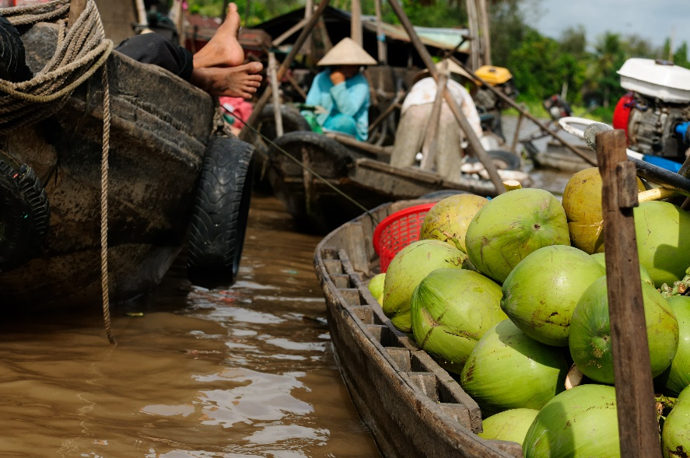
Minimise negative impact on the culture, people and environment
Key terms and concepts on this topics include:
Ethical tourism
Sustainable tourism
Green tourism
Fair Trade in tourism
Notes:
Trainer indicates key terms often used to describe and create awareness and action associated with relevant issues are:
Ethical Tourism
Sustainable Tourism
Green Tourism
Fair Trade in Tourism.
Class Activity – Internet Research
Trainer facilitates student research of and discussion regarding content of following and other similar/relevant websites:
http://www2.unescobkk.org/elib/publications/IMPACT_LuangPrabang/impact.pdf - The effects of tourism on culture and the environment in Asia and the Pacific
http://www.toinitiative.org/fileadmin/docs/publications/sustainable_tourism.pdf - Sustainable Tourism: the Tour Operators’ Contribution
http://www.tourismconcern.org.uk/principles-and-definitions.html - TourismConcern: Action for ethical tourism
http://www.unesco.org/education/tlsf/mods/theme_c/mod16.html - Sustainable tourism

Slide 133
Minimise negative impact on the culture, people and environment
Ways to determine what is required:
Talk to relevant people:
Communities and elders
Tour Operator and other Tour Guides
Government officials
Local stakeholders
Read relevant documents:
Internal and internal
Notes:
Trainer identifies the standard and effective ways to determine what is required to minimise the negative impact of tours on local culture, people and the environment are to:
Talk to relevant people
Local elders and communities
Other and more experienced Tour Guides
The employer/Tour Operator
Government officials who have involvement in and responsibility for local areas and tourism
Local industry tour groups and associations – who will have been engaged in liaising with local stakeholders and with developing protocols for minimising impact.
Read relevant documentation
In many instances documentation has been developed to provide advice, guidelines of mandatory requirements to assist Tour Guides and Tourist Operators to minimise the impact of tours.
Documents may include those which are internal to the Tour Operator and imposed externally.
External documents
Legislation – Acts and Regulations; Local by-laws; Codes of Practice; Charters; Agreements
Internal documents
Policies; SOPs; Contracts; Terms and conditions; Commitments – made to compliance with relevant matters.
Class Activity (1) – Handouts
Trainer distributes documents identified on slide and discusses their role in relation to minimising the impact/s of tours.
Class Activity (2) – Guest Speaker
Trainer arranges for Government official to attend and present requirements for Tour Operators and Tour Guides in relation to minimising impact of tours on local culture, people and/or environment

Slide 134

Minimise negative impact on the culture, people and environment
Practical and effective ways to minimise negative impact of tours:
Be sensitive to ecological issues:
Limit use of local water
Do not leave rubbish
Do nothing to erode the land
(Continued)
Notes:
Trainer notes practical procedures for minimising the negative impact of tours will usually also seek to optimise the positive impact of tours stating the following have emerged as effective actions:
Be careful and sensitive in relation to ecological issues – do nothing to negatively impact the local ecology/environment:
Limit local water use
Never leave rubbish behind
Take care to do nothing which erodes the land.

Slide 135

Minimise negative impact on the culture, people and environment
Control visitations:
Setting visitor and tour limits
Offering alternatives where a negative impact is deemed possible/probable
Managing tours and tour group members
(Continued)
Notes:
Trainer continues presenting practical procedures for minimising the negative impact of tours:
Control visitations – by:
Setting limits for:
Maximum numbers on a tour
Number of visits/tours to an area/destination per day, week or other period
Developing and offering alternatives – to tours to sensitive areas
Providing effective management of tours and tour group members.

Slide 136

Minimise negative impact on the culture, people and environment
Be mindful of local need:
Do not tour at ‘restricted’ times
Do not enter prohibited areas
Walk only on paths
Maintain distance
(Continued)
Notes:
Trainer continues presenting practical procedures for minimising the negative impact of tours:
Be mindful of local persons, activities and preferences if asked by a local community – for example:
Do not operate tours at times/on days identified by locals as being ‘restricted’ in some way (such as because of local religious or other beliefs, due to established local custom, as a result of the needs, wants and preferences of local people)
Do not enter nominated areas – in certain locales
Walk only on designated paths
Do not go within a given distance of wildlife, activities, persons, buildings or other nominated events.

Slide 137
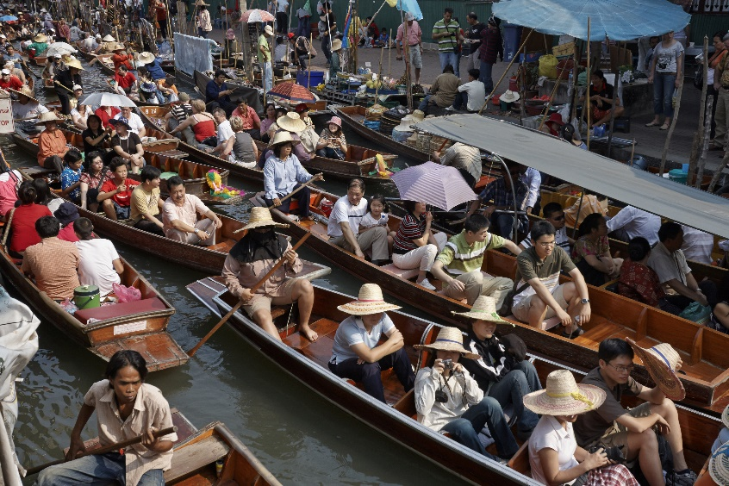
Minimise negative impact on the culture, people and environment
Ask tour group members to avoid certain actions as appropriate to the community/environment
Restrict numbers entering an area
Advise tour members to ask for permission to take photographs
(Continued)
Notes:
Trainer continues presenting practical procedures for minimising the negative impact of tours:
Ask tourists not to look at and/or intervene in nominated things – or initiate conversation with local people
Advise and demonstrate to tourists important aspects of local manners – and what is considered normal and acceptable, as well as what is deemed to be rude and disrespectful
Restrict numbers of tourists who enter an area – to reduce their immediate impact and to limit unintentional disturbance/interference with normal activities
Ask tourists not to stare at locals
Where appropriate, tell visitors to ask for permission before taking photographs – or ban taking of cameras/cell phones into certain areas.

Slide 138

Minimise negative impact on the culture, people and environment
Commit to compliance in a genuine and public way:
Make suitable public statements
Advise tour groups of the standards which must be complied with, the obligations the tour operates under and consequences for non-compliance
(Continued)
Notes:
Trainer continues presenting practical procedures for minimising the negative impact of tours:
Commit to compliance – this means:
Making public statements the tour and the Tour Guide and Tour Operator:
Is committed to nominated Codes and Agreements
Is committed to observing and implementing all relevant legislation
Advising tour groups:
Of the limitations/restrictions imposed on tours by Agreements, Codes and legislation
Scheduled activities and the planned itinerary are subject to change where the Tour Guide believes they will negatively impact the local area
Anyone identified as breaching requirements in this regard will be asked to modify their behaviour and/or leave the tour.

Slide 139

Minimise negative impact on the culture, people and environment
Participate in planning:
Provide input to development of principles and practices for responsible and sustainable tourism
Contribute to establishment of suitable tours
Provide feedback from personal experience
Be prepared to assist with trialling and reporting on initiatives
Notes:
Trainer continues presenting practical procedures for minimising the negative impact of tours:
Participate in planning – as Tour Guides it is important to:
Take part in discussions about principles and practices for responsible and sustainable tour actions
Provide feedback and input to the planning process based on personal experiences and observations
Be prepared to implement and trial draft policies and procedures.
Class Activity – Major Individual Assignment
Trainer asks students to plan and conduct a local walking or vehicle-based tour.
Tour must:
Have duration of 60 – 90 minutes
Be conducted as a professional tour for fee-paying members of the public
Feature:
An itinerary
A scripted commentary
At least one activity/event
Required pre-departure checks
On-arrival activities
During-tour activities
End-of-tour activities.

Slide 140

Summary – Element 3
When providing guiding services:
Identify and undertake required pre-departure checks and activities
Determine and discharge all required on-tour activities and obligations
Establish and complete all identified/required end-of-tour activities
(Continued)
Notes:
Trainer provides a recap of the Element asking questions to check trainee understanding and responding to questions from trainees, as required.

Slide 141

Summary – Element 3
Prepare and deliver commentaries as required
Manage the tour group and resolve issues arising
Implement contingency and emergency plans as/when necessary
(Continued)
Notes:
Trainer provides a recap of the Element asking questions to check trainee understanding and responding to questions from trainees, as required.

Slide 142

Summary – Element 3
Ensure compliance with tour promises, safety requirements, ethical obligations and ethical standards
Observe respect for local communities and culture/s
Demonstrate action designed to optimise visitor engagement and experiences while minimising negative impacts of the tour
(Continued)
Notes:
Trainer provides a recap of the Element asking questions to check trainee understanding and responding to questions from trainees, as required.

Slide 143

Summary – Element 3
Optimise positive impacts of the tour
Respect everyone associated with the tour
Apply effective interpersonal, communication and group leadership skills
Notes:
Trainer provides a recap of the Element asking questions to check trainee understanding and responding to questions from trainees, as required.

Slide 144
Element 4 – Communicate with industry personnel
Performance Criteria for this Element are:
Communicate with tourism industry operators
Communicate with colleagues
Notes:
Trainer identifies for trainees the Performance Criteria for this Element, as listed on the slide.
Class Activity – General Discussion
Trainer leads a general class discussion by asking questions such as:
Which/what industry personnel might there be a need to communicate with?
Why?
When could/would this occur?

Slide 145
Communicate with tourism industry operators
Need for communication with industry operators will depend on:
Type of tours conducted
Associations and relations between tour company and other operators
Contracted obligations
Commitment by business to Codes and accords
Notes:
Trainer observes the exact nature of the cross-section of industry operators and personnel a Tour Guide might need to communicate with will depend on:
The type of tours being conducted – daily half-day city walking tours will involve different stakeholders to 10-day camping tours of six different countries
Associations and relations between the Tour Operator and others – under contracts, strategic partnerships, joint ventures, partnerships
Contracted obligations – imposed as a consequence of legally binding contracts requiring (for example) attendance at meetings and/or provisions of feedback or reports
Commitment by the business to Codes and similar other voluntary accords – which require participation in nominated events, seminars, meetings, conventions, conferences and similar.

Slide 146
Communicate with tourism industry operators
Industry operators to communicate with:
Carriers
Destinations and attractions
Third party providers
Tour-based operators
Notes:
Trainer identifies there can be a need for Tour Guides to communicate with:
Carriers – who can include:
Coach companies
Cruise operators
Airlines
Other transport operators
Destinations:
Businesses
Built attractions
Natural attractions
Boards of Management and/or owners and/or staff
Third party providers:
Accommodation providers
Caterers and food and beverage outlets
Tour-based operators::
Other Tour Operators – local, national and international
Inbound Tour Operators
Wholesale Tour Operators.
Class Activity – Guest Speakers
Trainer arranges for a range of Guest Speakers from those listed above to attend and talk about the communication they have/want with Tour Guides and Tour Operators.

Slide 147
Communicate with tourism industry operators
Possible topics for discussion:
Feedback from tour group members
Results of market research conducted
Recommendations
Social, cultural and business requirements and contexts
Problems
Notes:
Trainer identifies possible topics for discussion:
Feedback from tourists about:
Satisfaction levels; Suggestions for change; Special requests; Best/worst aspects of their experience; Regular/common complaints and compliments
Results of customer/market research conducted by the business in relation to a range of issues such as:
What they liked /disliked; Reasons for using the services of the business; Needs, wants and preferences
Recommendations for improvements and initiatives – in relation to:
Inclusions; Pricing; Destinations; Itineraries; Scheduling; Carriers
Social, cultural and business requirements and contexts - including practical implementation of tour delivery in relation to issues such as:
Verbal and body language; Cultural customs and mores; Ethical conduct; Sustainability
Identification of operational problems – and presentation of possible solutions to same based on personal experience and known operational parameters.

Slide 148
Communicate with tourism industry operators
Communication basics to observe:
Honour commitments made to attend/contribute
Use industry terms
Be collaborative and consultative
Be careful about what is said/shared
Notes:
Trainer describes communications which need to be observed in this context:
Honour commitments – make an effort to:
Attend required meetings
Contribute as required or as promised
Learn what is required and meet those obligations
Use industry terminology – but clarify any terms, phrases, acronyms or abbreviations with the potential to confuse
Seek to:
Provide information
Source information
Achieve mutual understanding
Reach agreement on issues and guiding activities and protocols
Consult in an open manner
Be careful – take care to:
Differentiate personal opinion from employer point of view
Separate fact from opinion
Never commit the employer to anything without their express permission
Ask employer to approve statements or comments to be made on behalf of the organisation.

Slide 149

Communicate with colleagues
Tour Guides may need to communicate with:
Other Tour Guides
Support staff
Drivers
Management
Notes:
Trainer notes in most cases Tour Guides will have some need to communicate with the following colleagues
Other guides – within the same Tour Operator organisation who may be:
Those who conduct similar/the same type of tours
Those who conduct other tour types with different durations, itineraries, destinations, inclusions and tour groups
Support staff – who can include any employees (but often predominantly office staff and counter service staff) within the host organisation with responsibility for things such as:
Market research
Customer contact
Bookings and sales
Administration which underpins the work of Tour Guides
Staff who arrange and organise activities, products, services and provisions/resources for Tour Guides
Drivers – of vehicles such as buses, vans, cars, utility vehicles, four-wheel drives and other specialist vehicles which may be:
Owned
Leased
Hired or rented by the employer
Management of the business – which may include:
Owners
Managers
Supervisors.

Slide 150

Communicate with colleagues
Opportunities for communication:
Daily briefing sessions
Internal staff ‘Communications’ book
Staff meetings
Internal forms and reports
‘Open door’ policy of management
Notes:
Trainer indicates opportunities for communication with other colleagues include:
Daily briefing sessions
The ‘Communication Book’ or similar used by many employers
Regular staff meetings
Chance meetings with others
Use of internal communication forms and reports which need to be completed before, during and at the end of tours- and after designated activities such as various checks and inspections
Taking advantage of ‘open door’ policy implemented by management.
It is vital Tour Guides create/make opportunities to communicate when they have something to say/something they want to share or communicate.
Class Activity – Guest Speaker
Trainer arranges for Tour Guide to attend and discuss communication they have with industry personnel and colleagues identifying when this occurs, how it occurs and the topics/reason for communication.

Slide 151

Communicate with colleagues
Communication methods:
Making presentations at meetings
Talking to people
Using written communication
Using electronic communication options
Notes:
Trainer states methods to communicate with colleagues are likely to include:
Making presentations at meetings – involving a range/combination of:
Speech, discussion and talking
Handouts
Slide presentations
Guest Speakers
Demonstrations
Talking to people:
Face-to-face
On the telephone
One-on-one
In groups
Using written communication options:
Providing handouts of information to be conveyed
Supplying hard copy suggestions/recommendations
Putting complaints and issues in writing
Completing internal forms and reports
Sending memoranda
Using electronic communication options – such as:
Email
Text messaging.

Slide 152
Summary – Element 4
When communicating with industry personnel:
Identify those with whom communication is required
Communicate on a regular basis and ‘as required’
Communicate using a variety of techniques and opportunities/options
(Continued)
Notes:
Trainer provides a recap of the Element asking questions to check trainee understanding and responding to questions from trainees, as required.

Slide 153
Summary – Element 4
Be clear in what is communicated
Differentiate fact from opinion
Never speak on behalf of employer without their express permission
(Continued)
Notes:
Trainer provides a recap of the Element asking questions to check trainee understanding and responding to questions from trainees, as required.

Slide 154
Summary – Element 4
Be prepared to share insight, experience and feedback received from tour group members
Contribute to the greater good and for the benefit of everyone
Make an effort to communicate – be proactive
Notes:
Trainer provides a recap of the Element asking questions to check trainee understanding and responding to questions from trainees, as required.
Trainer thanks trainees for their attention and encourages them to apply course content as required in their workplace activities.

